Slide 1

Proud Lilywhites
2021/22
Notes:
So we're constitutionally obliged to do a Chair's report; it's great to think back over our season and these are the highlights--rest assured there's much more
I'm really proud of the Proud Lilywhites and everything we have achieved, together, these past 8 years
Just yesterday... CPS, Mogi asylum, Serge Aurier and all the countless etc.

Slide 2
Visibility & Our Members
Notes:
The reason why we exist, all of you

Slide 3
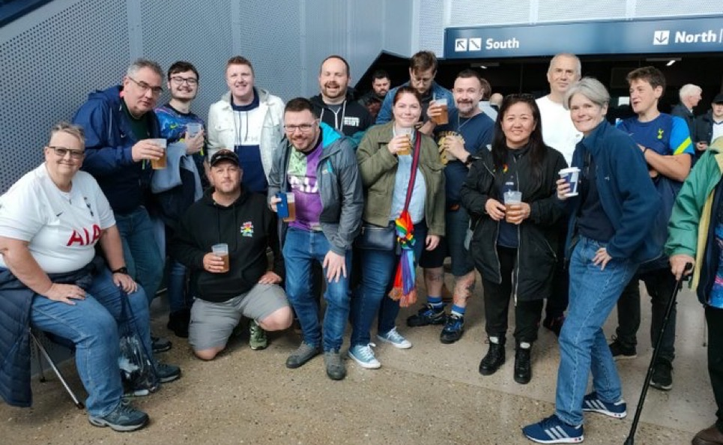
This season we were back to full capacity at the stadium…
And we re-started our matchday meet-ups

Slide 4
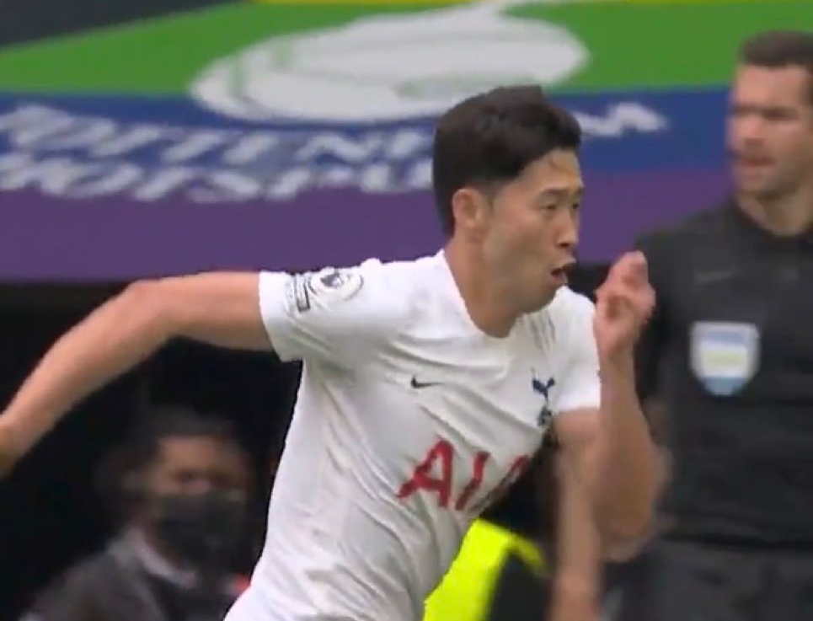
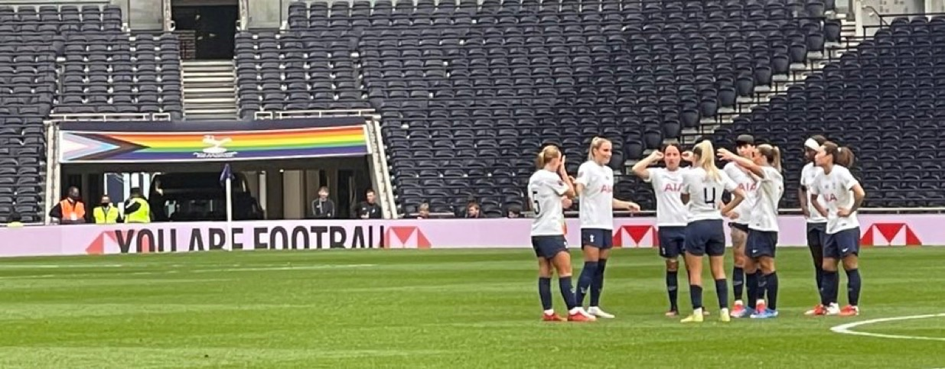
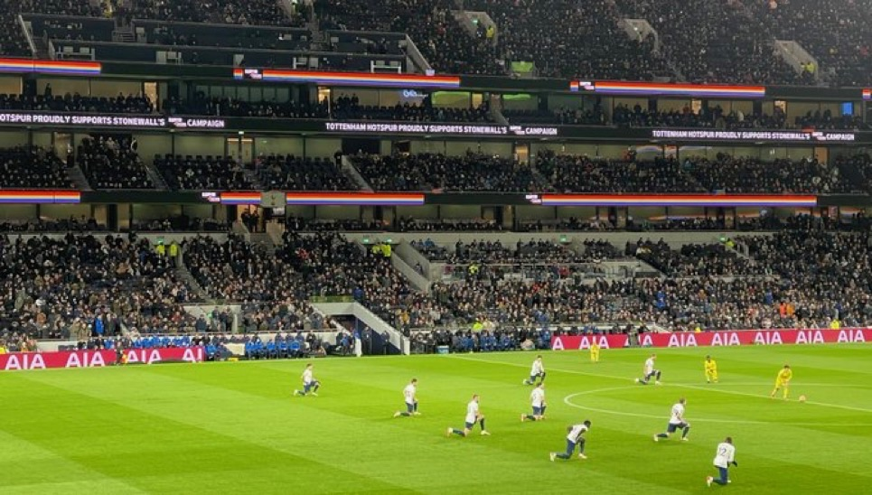
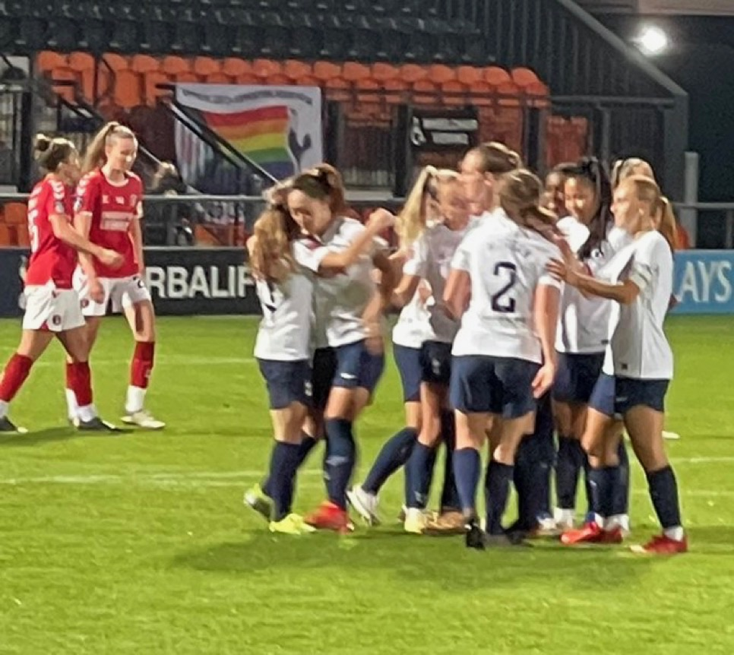
We’ve been visible at our stadia all season….

Slide 5
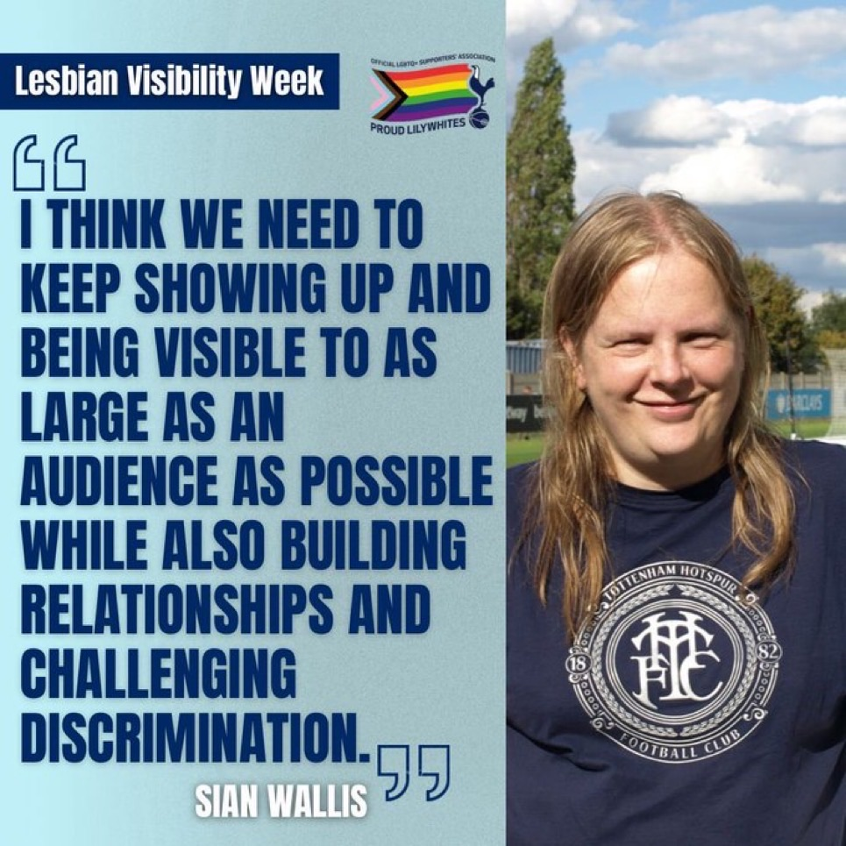
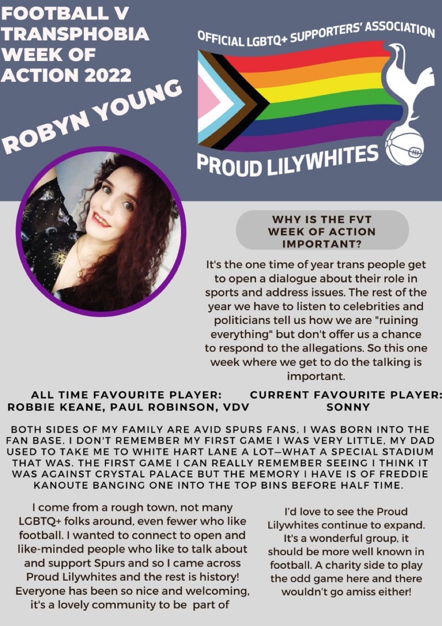
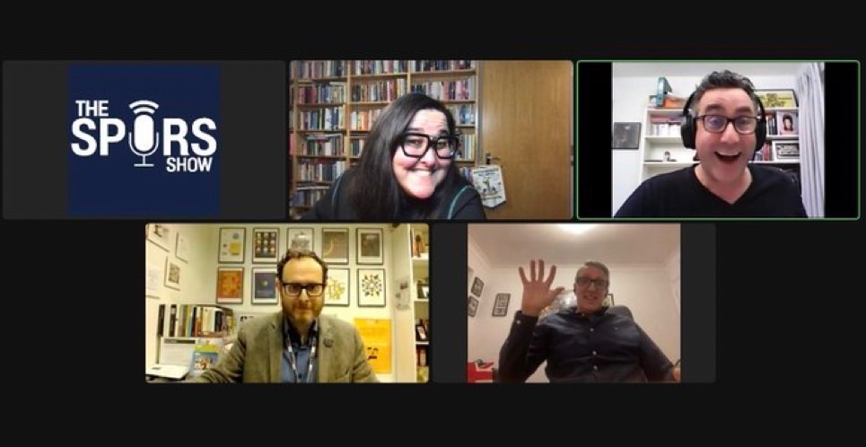
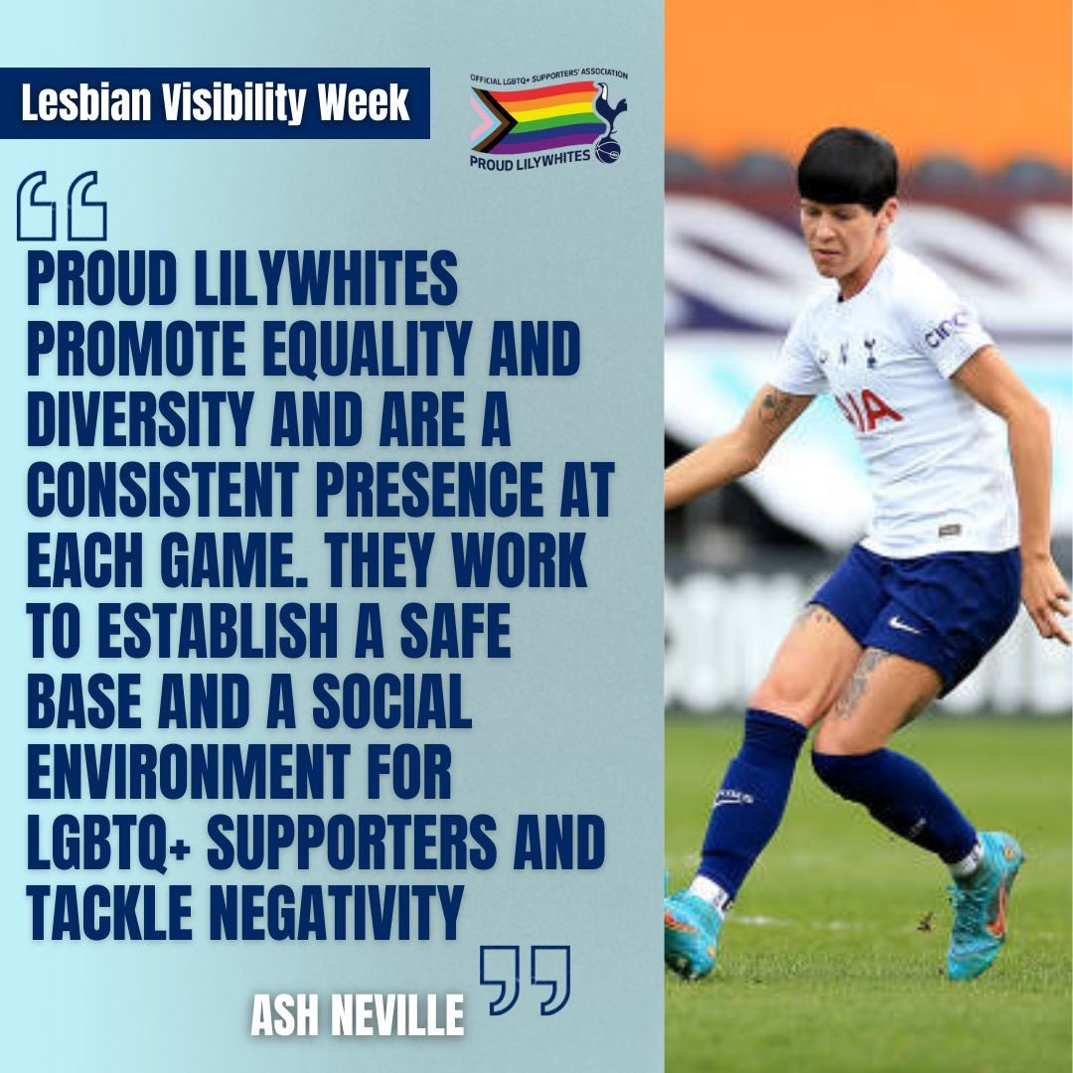
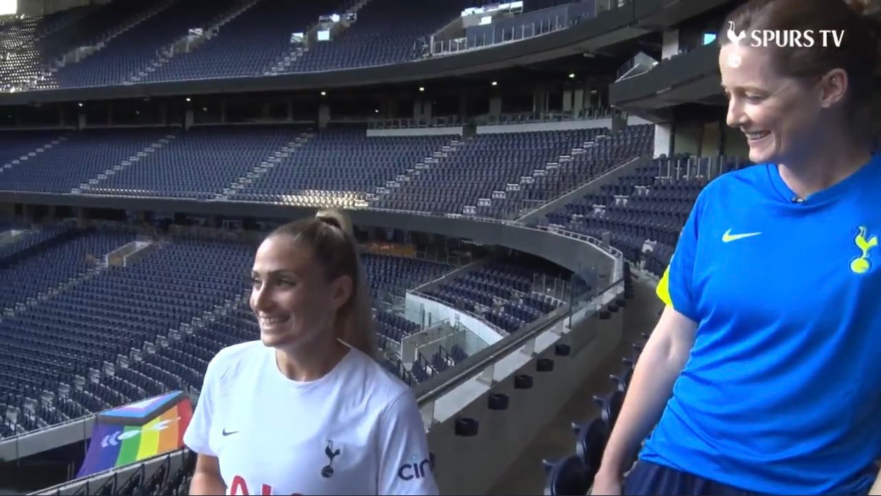
And we’ve been visible online too!
Notes:
LVW
FvT week of action
VArious pods from the Spurs Show to LWOS--all talking about the great work we do here, why this matters -- i\ve been a spurs fan..

Slide 6
Campaigns

Slide 7
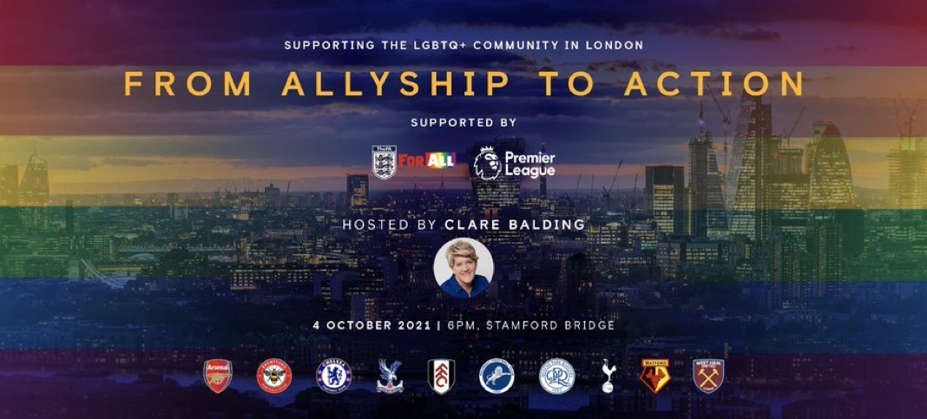
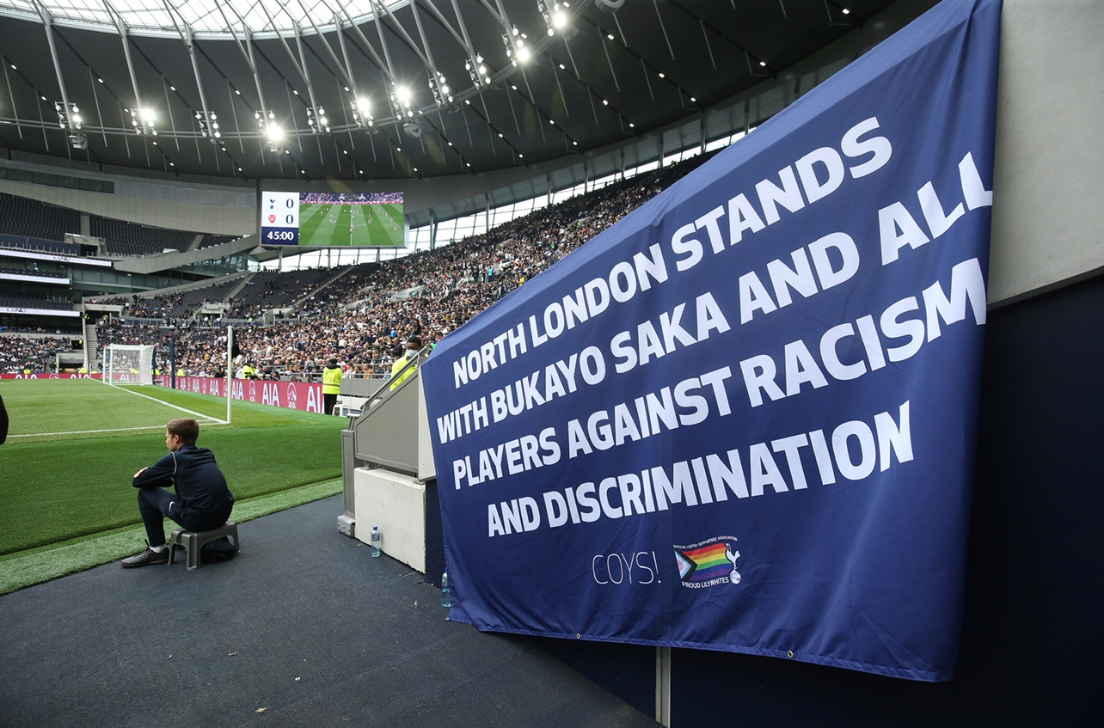

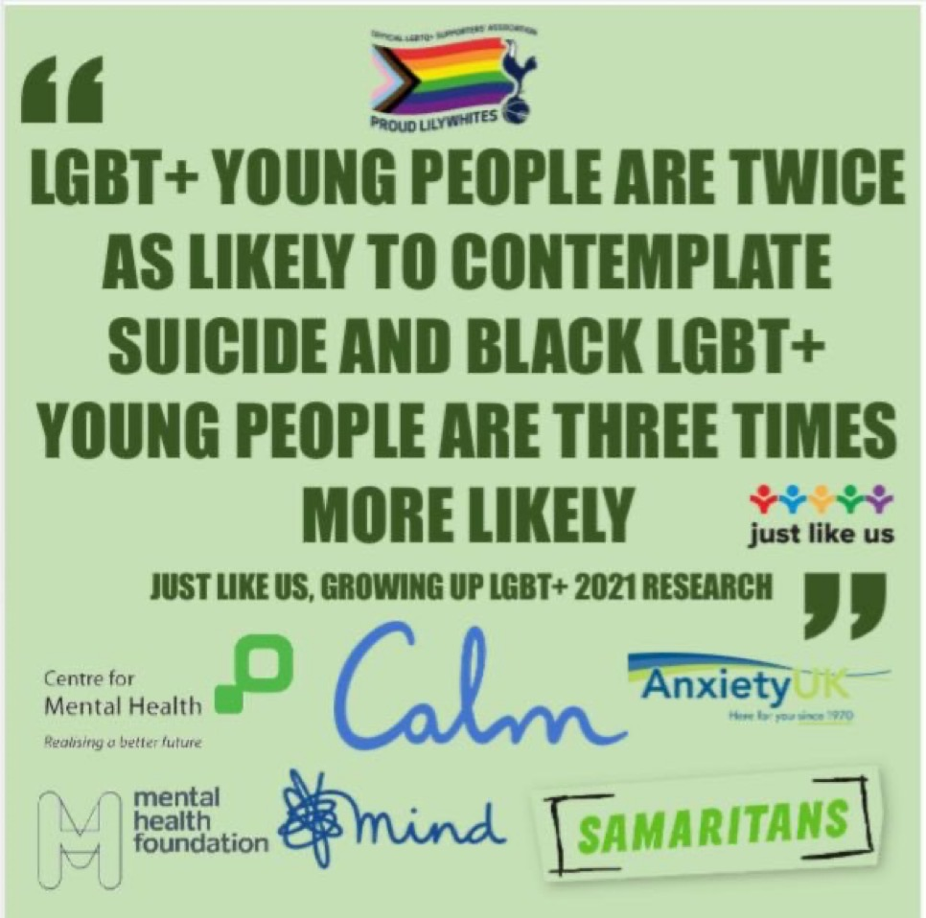
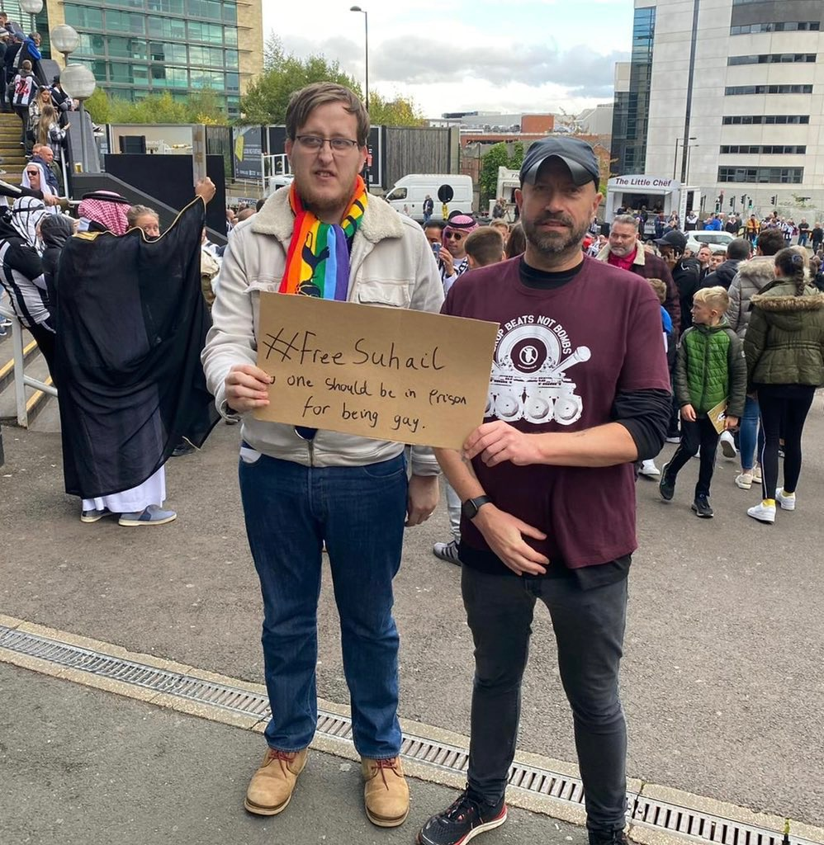
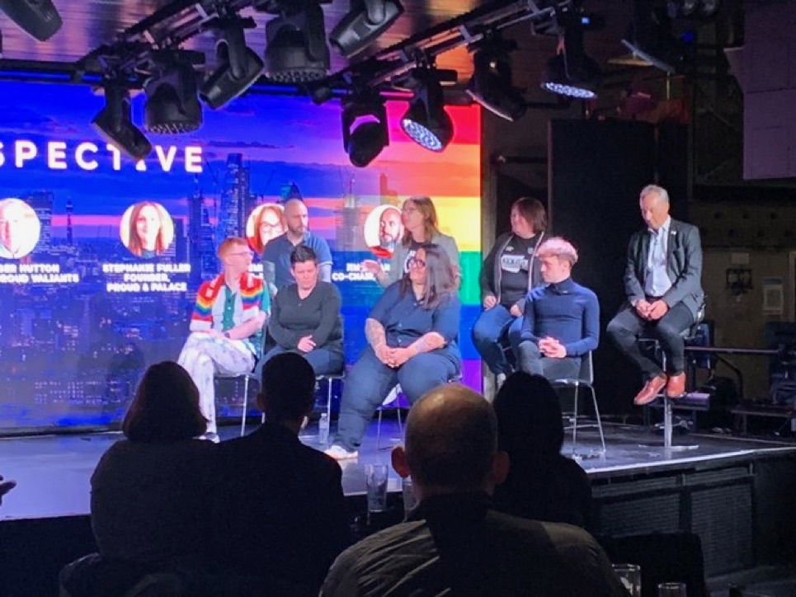
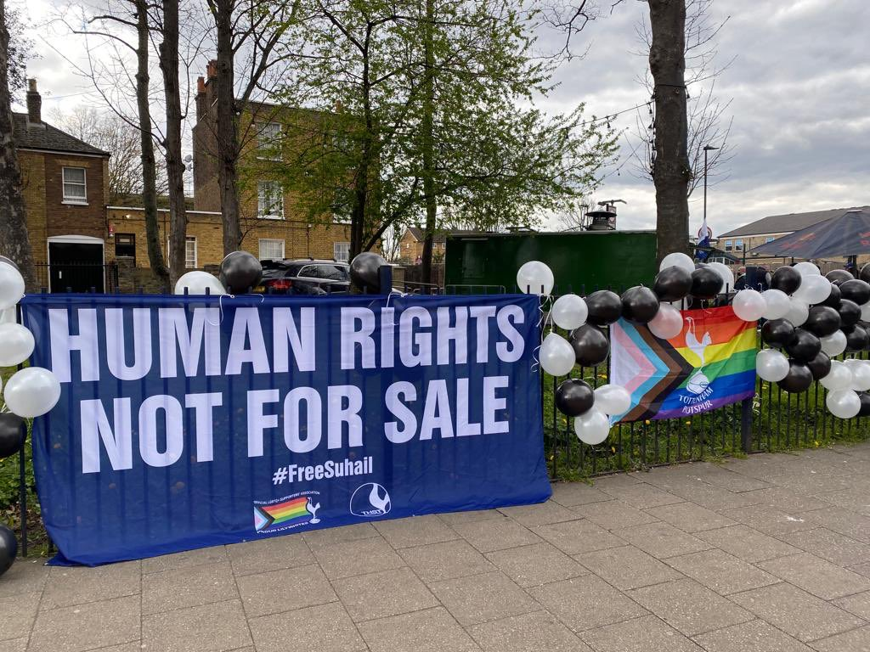
Our community continues to face great challenges both at home and around the world.
We will always campaign for voices that need to be heard and stand up against all discrimination.
Notes:
Mental Health
Suhail Al Jameel is an icon for LGBTQ+ people in Saudi Arabia. Suhail is currently reported to be in a political prison (which is worse than a normal one) and is alleged to have received 800 lashes, after posting a shirtless photograph on Twitter. His ‘crimes’; are purported to include “homosexuality”,” imitating a woman”, “disobedience” and “public indecency”. We started this campaign when Newcastle were first taken over (we were the fist team to play them) and hope that UK pressure could lead to his release.”

Slide 10
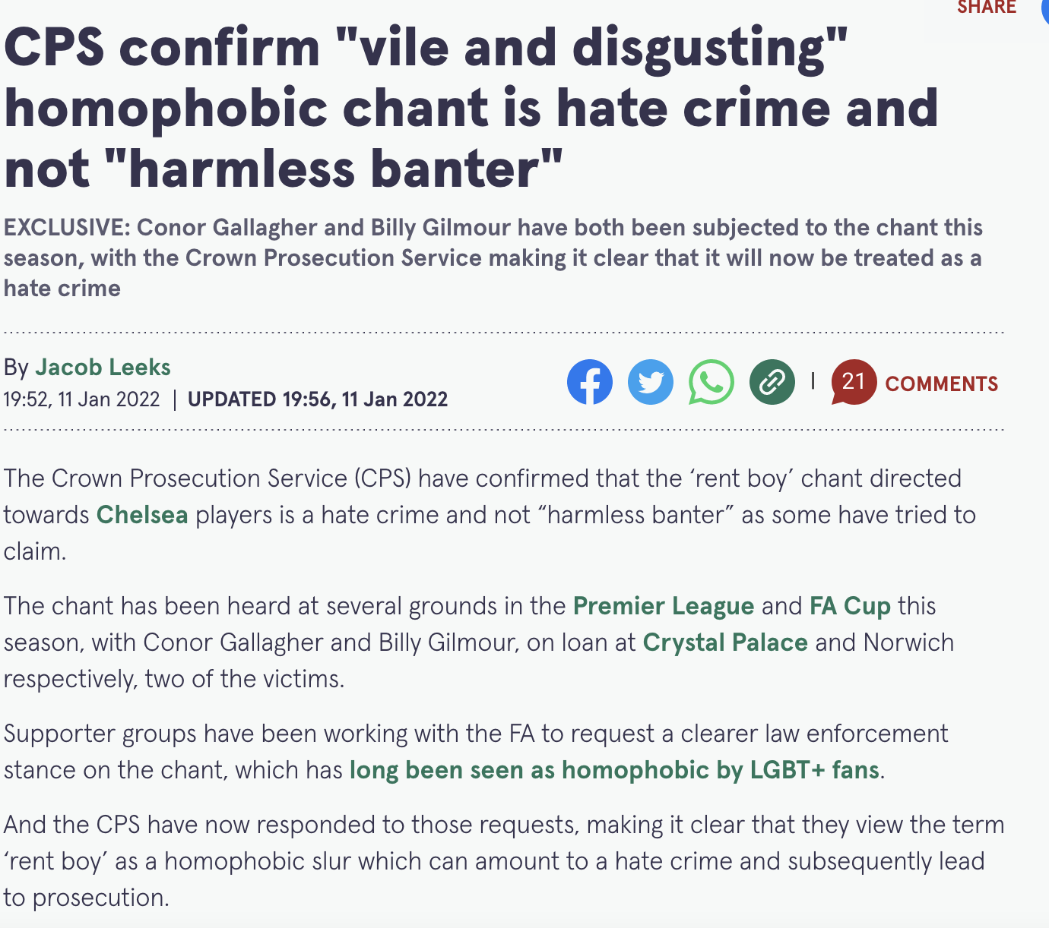
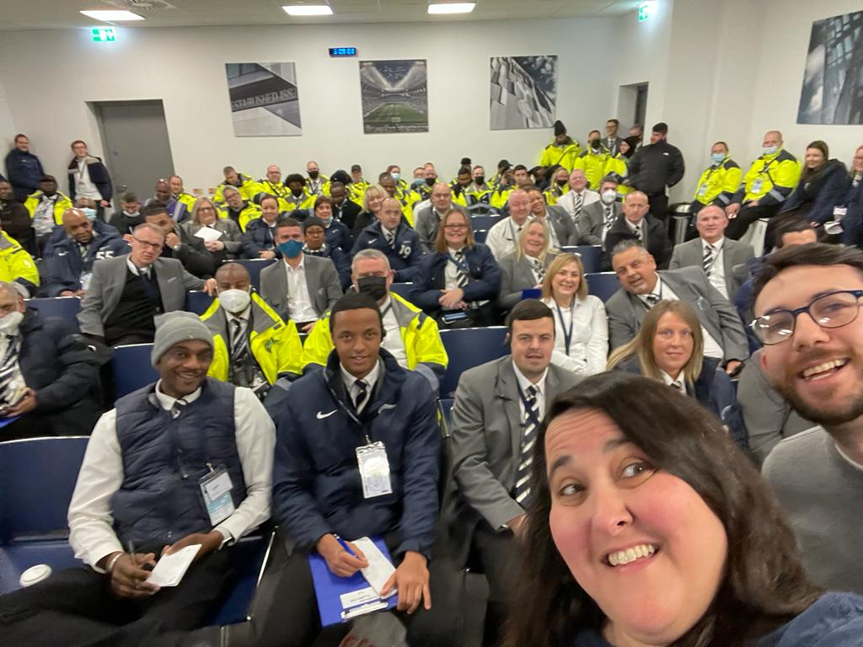
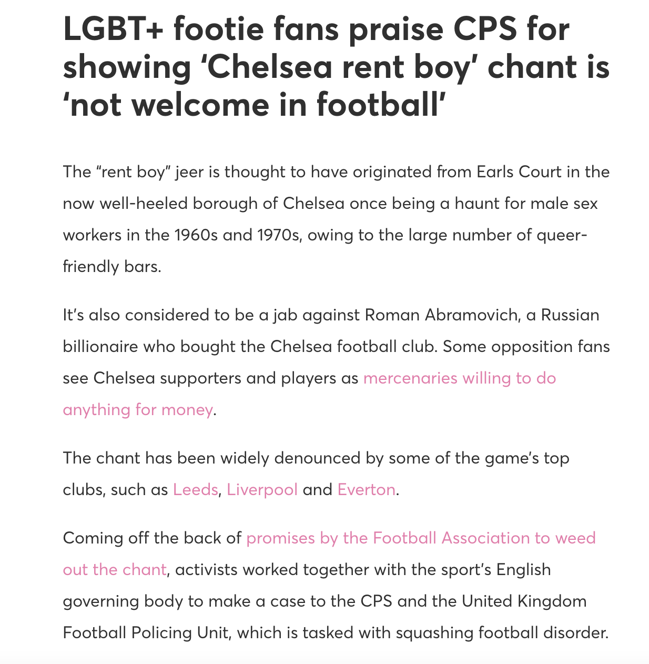
We drove the work to change the law
We delivered training to stewards about this chant and others that also have no place in our game
Notes:
Mental Health
Suhail Al Jameel is an icon for LGBTQ+ people in Saudi Arabia. Suhail is currently reported to be in a political prison (which is worse than a normal one) and is alleged to have received 800 lashes, after posting a shirtless photograph on Twitter. His ‘crimes’; are purported to include “homosexuality”,” imitating a woman”, “disobedience” and “public indecency”. We started this campaign when Newcastle were first taken over (we were the fist team to play them) and hope that UK pressure could lead to his release.”

Slide 11
Rainbow Laces 2021

Slide 12
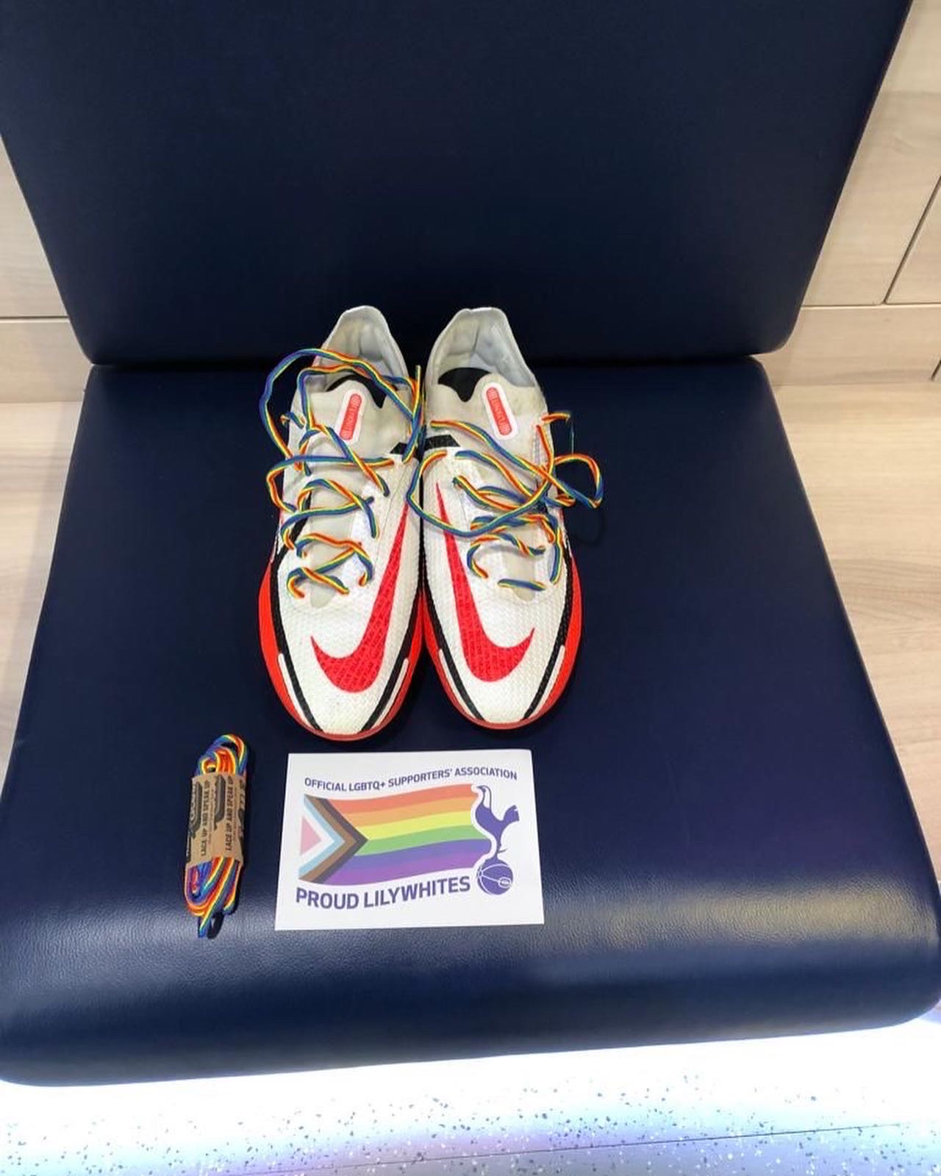
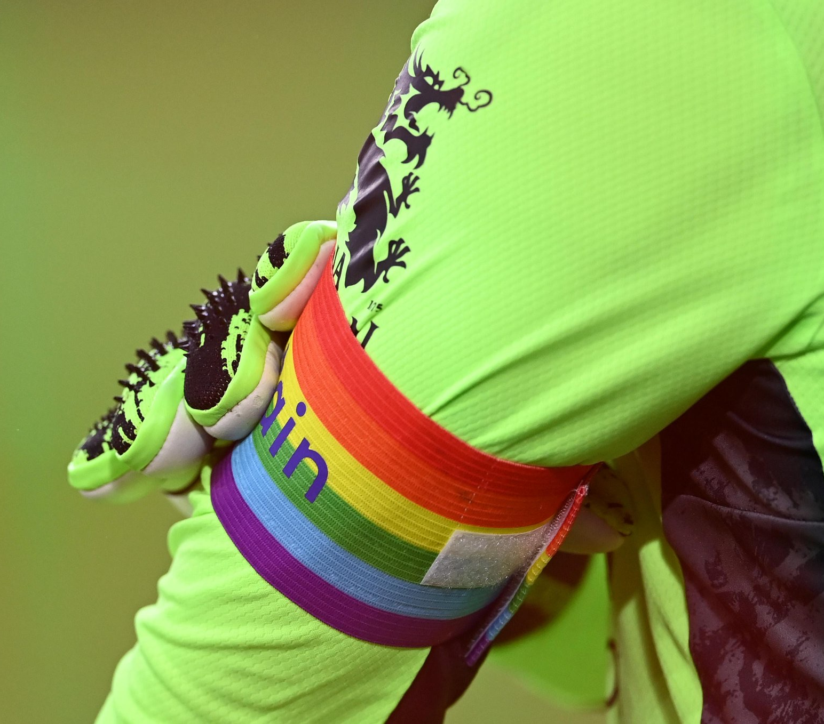
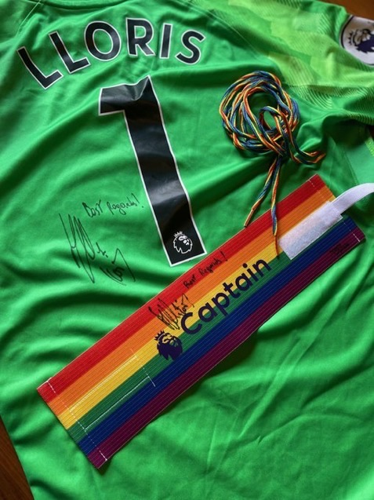
Eric Dier once again wore his rainbow laces…
…Hugo Lloris wore the rainbow captains armband…
…and he even signed his Shirt & Armband for us!
(But you’ll find out more about that later)

Slide 13
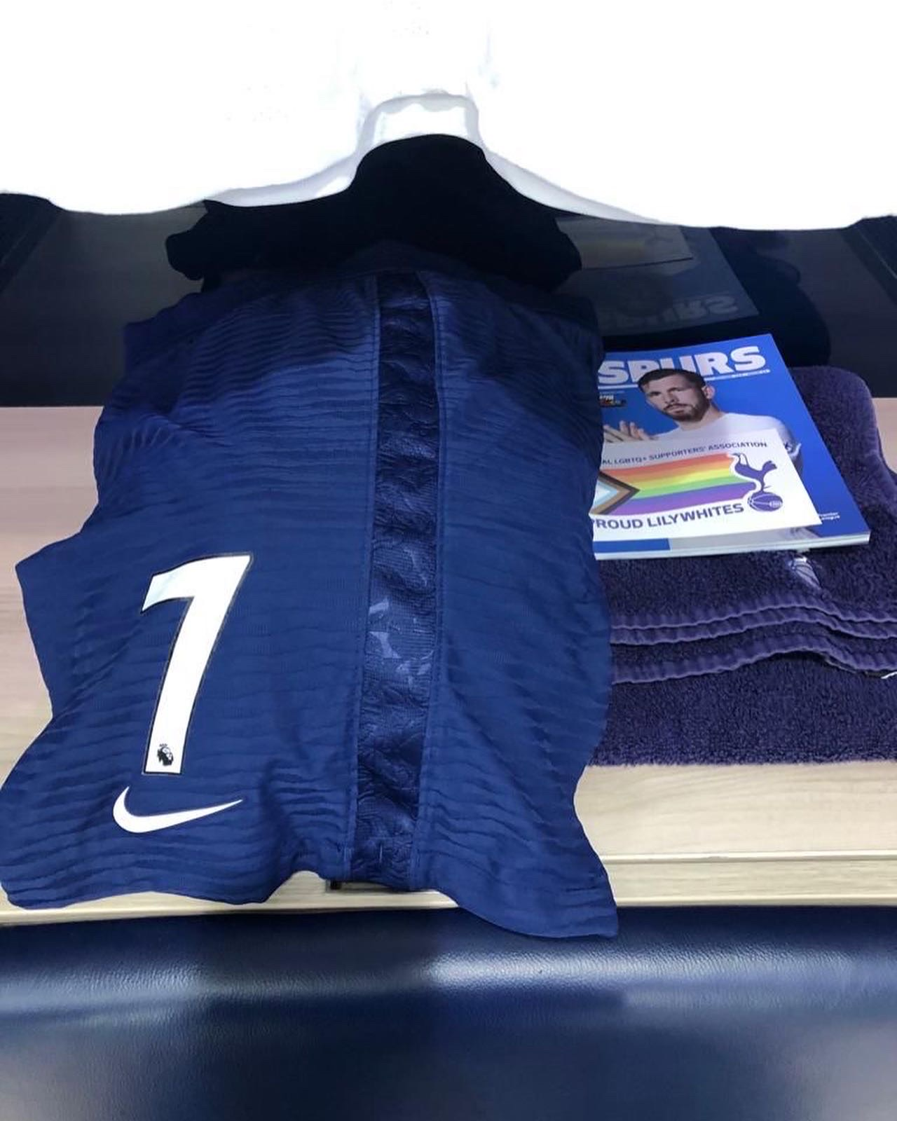
As part of our Rainbow Laces activity, we gave each of the players a pair of laces plus a ‘postcard’ from the Proud Lilywhites outlining why Rainbow Laces is important and how they can be great allies.
Notes:
Education (as well as campaigining and social / visibility) so we wanted to be sure the players were with us

Slide 14
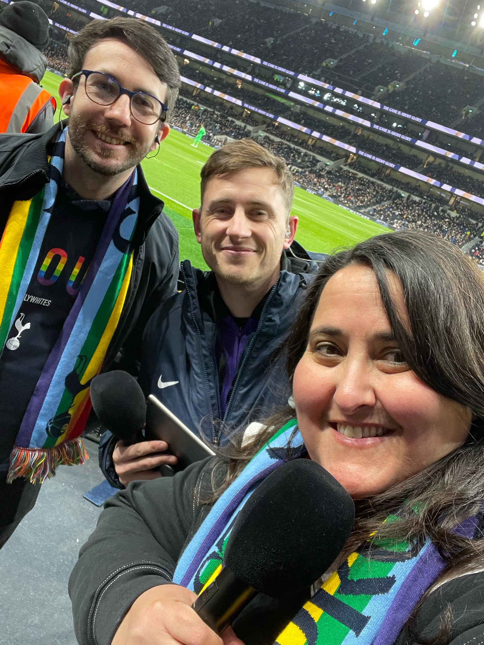
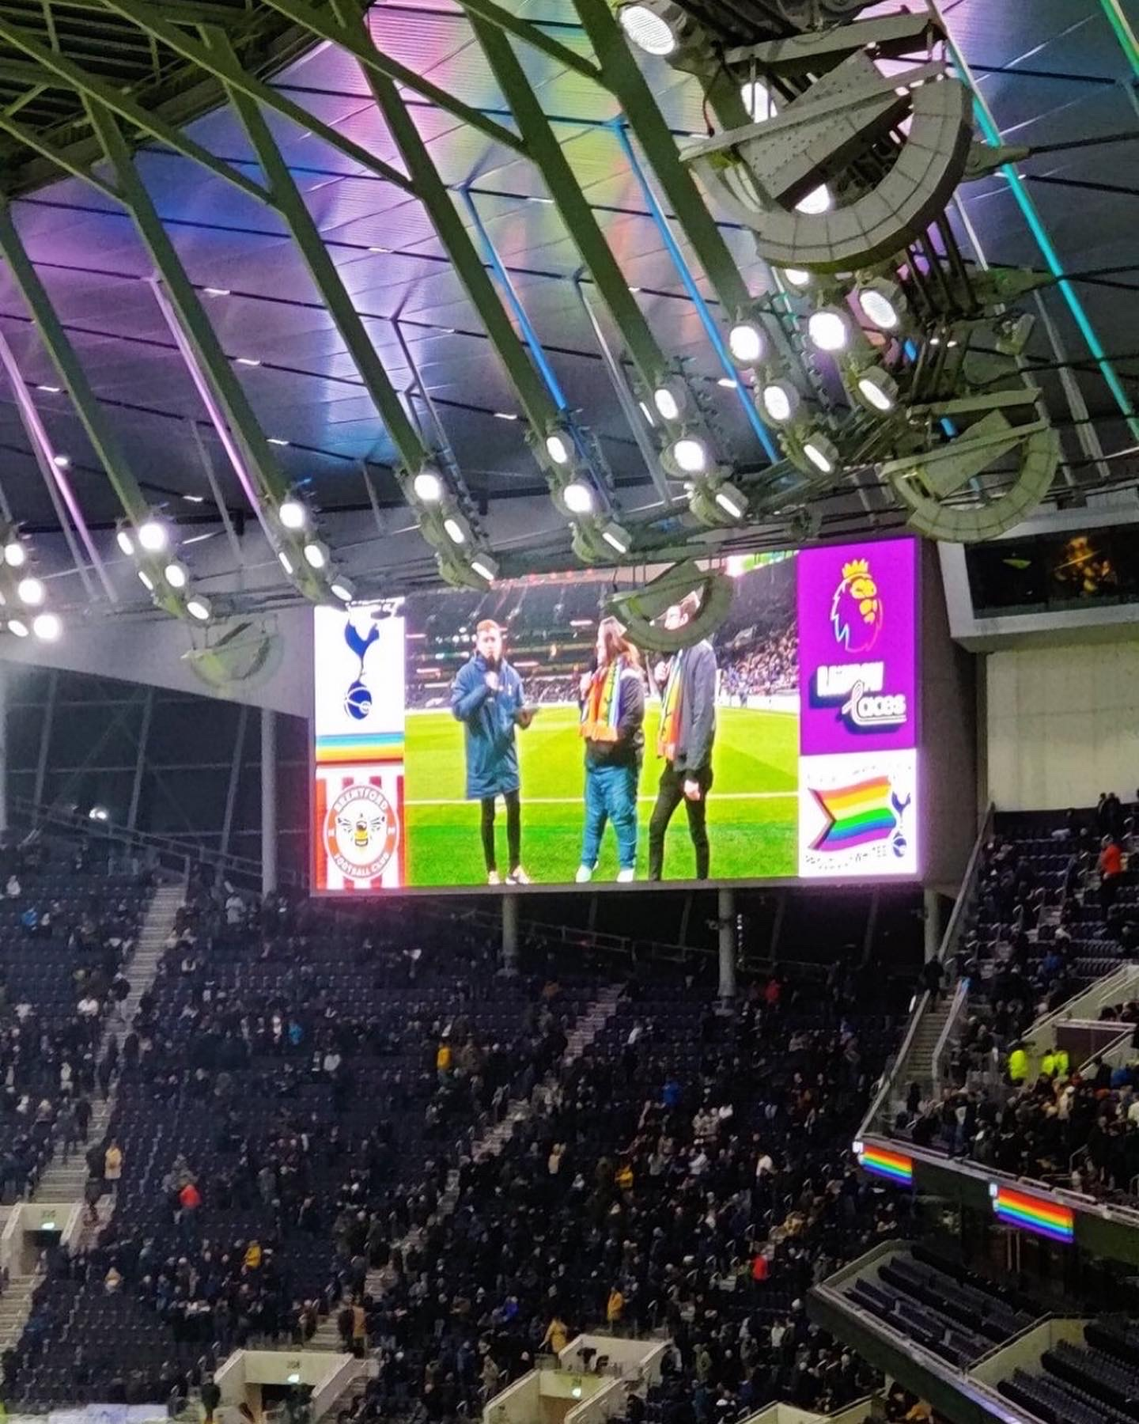
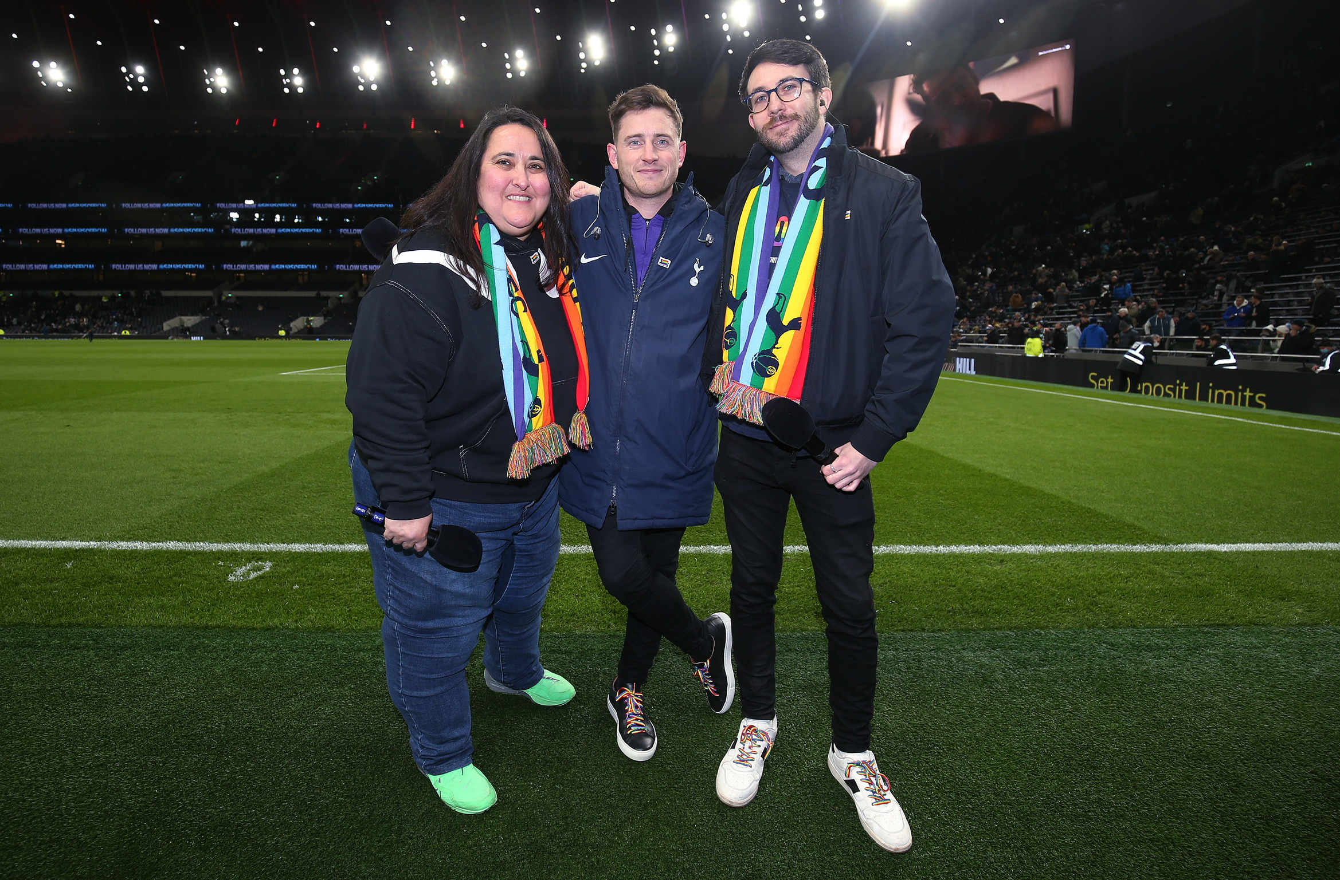
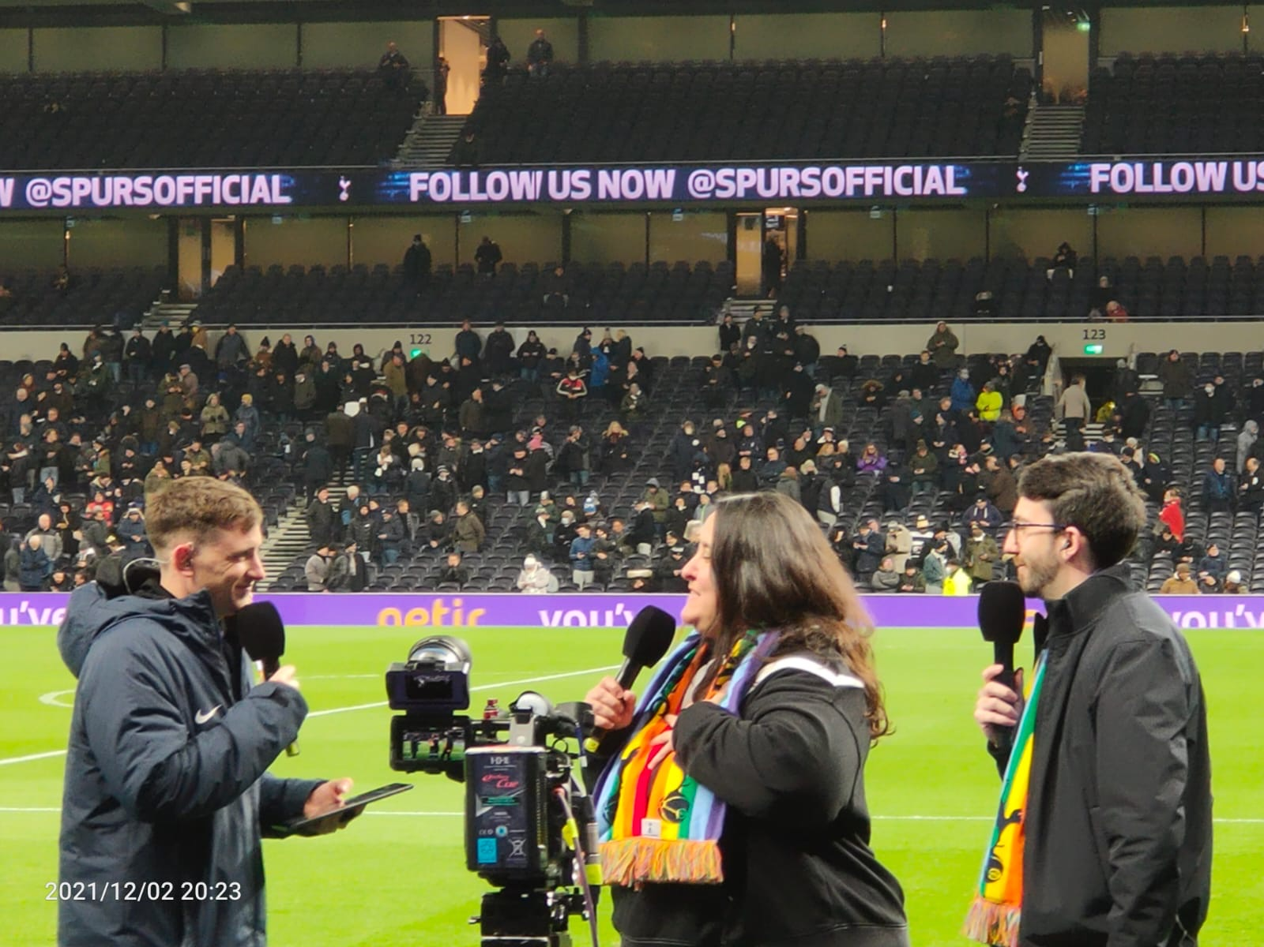
Our co-chairs Chris & Lee joined Ben Haines at half time to talk about the impact of LGBTQ+phobia in football, and discuss the important role the Proud Lilywhites have at Spurs

Slide 15
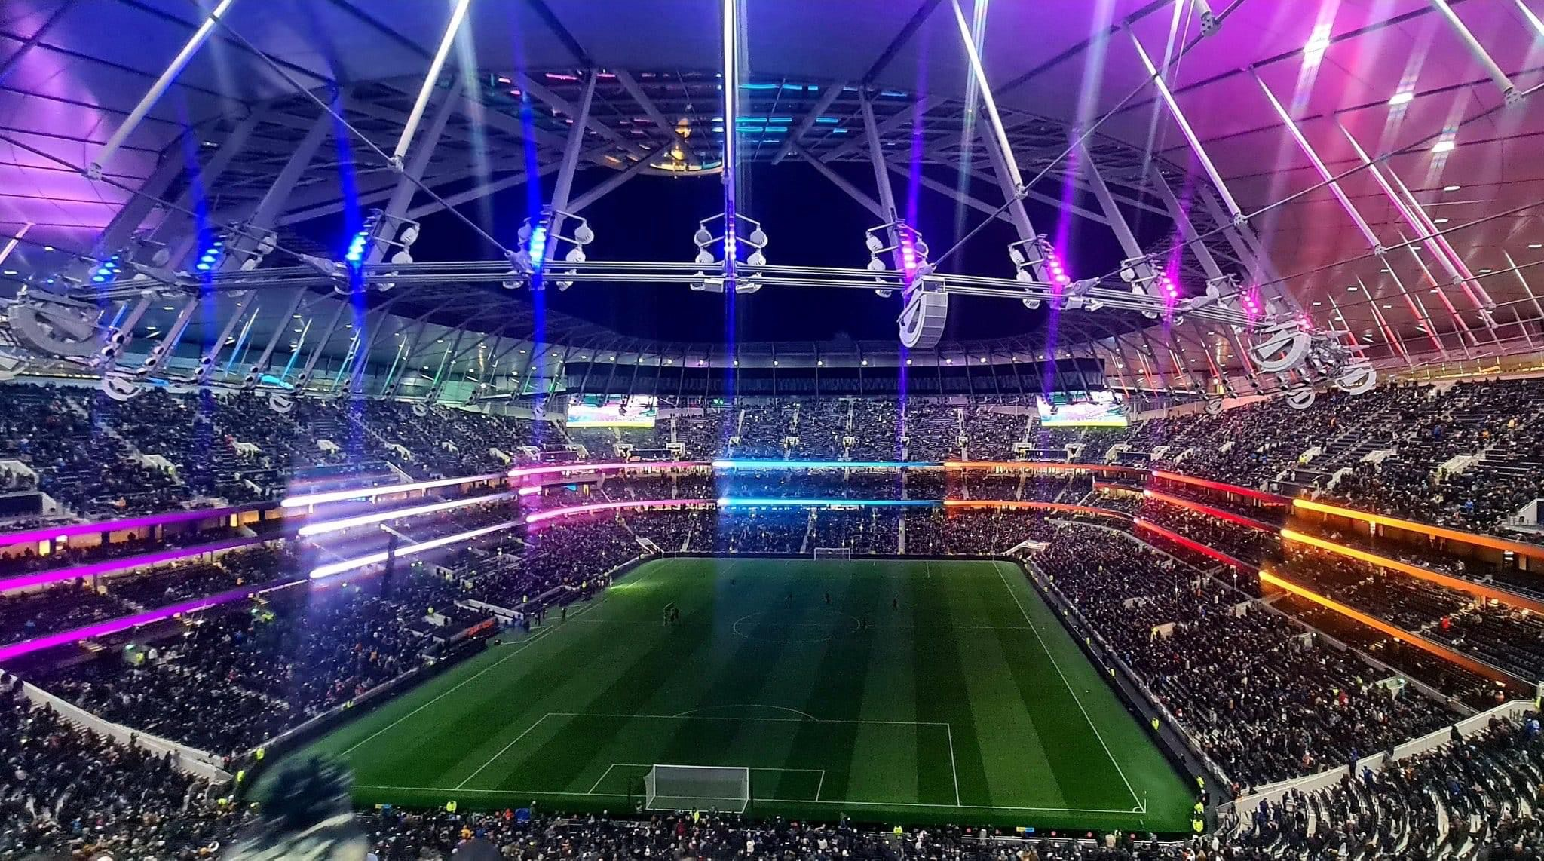
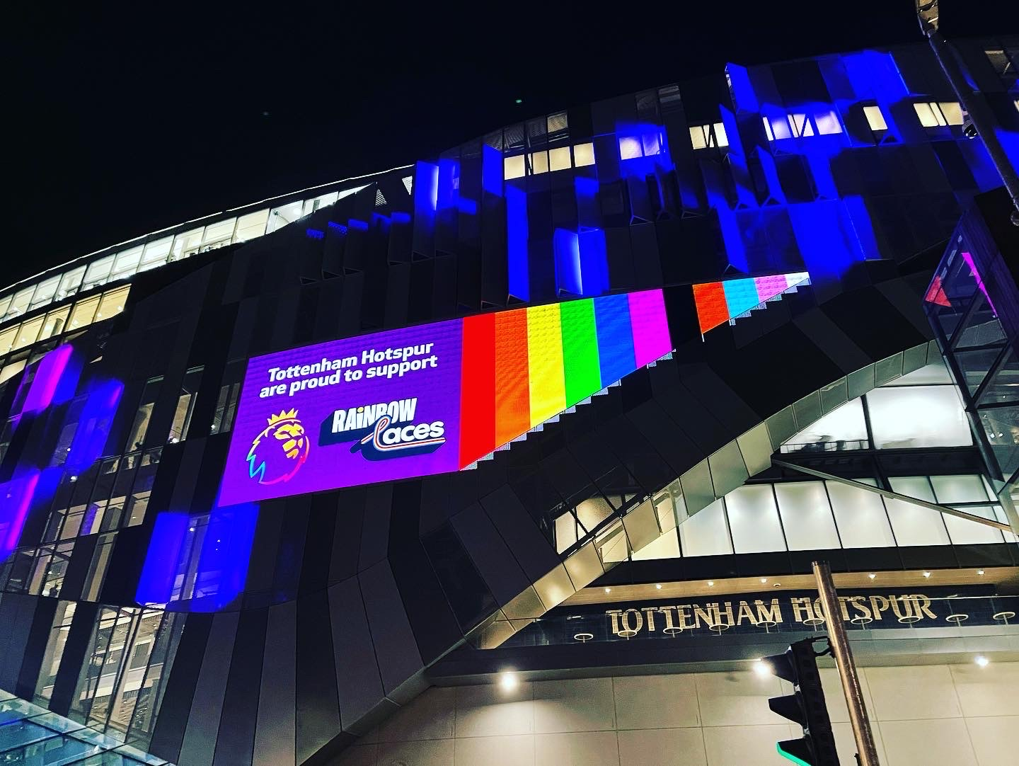
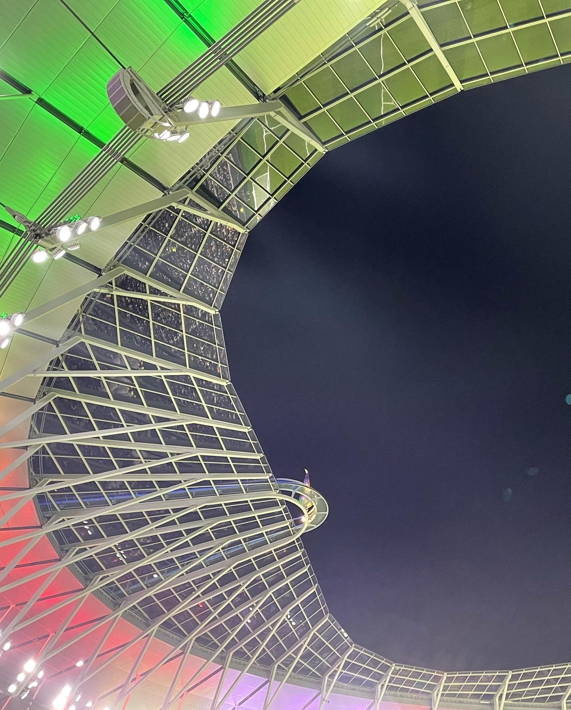
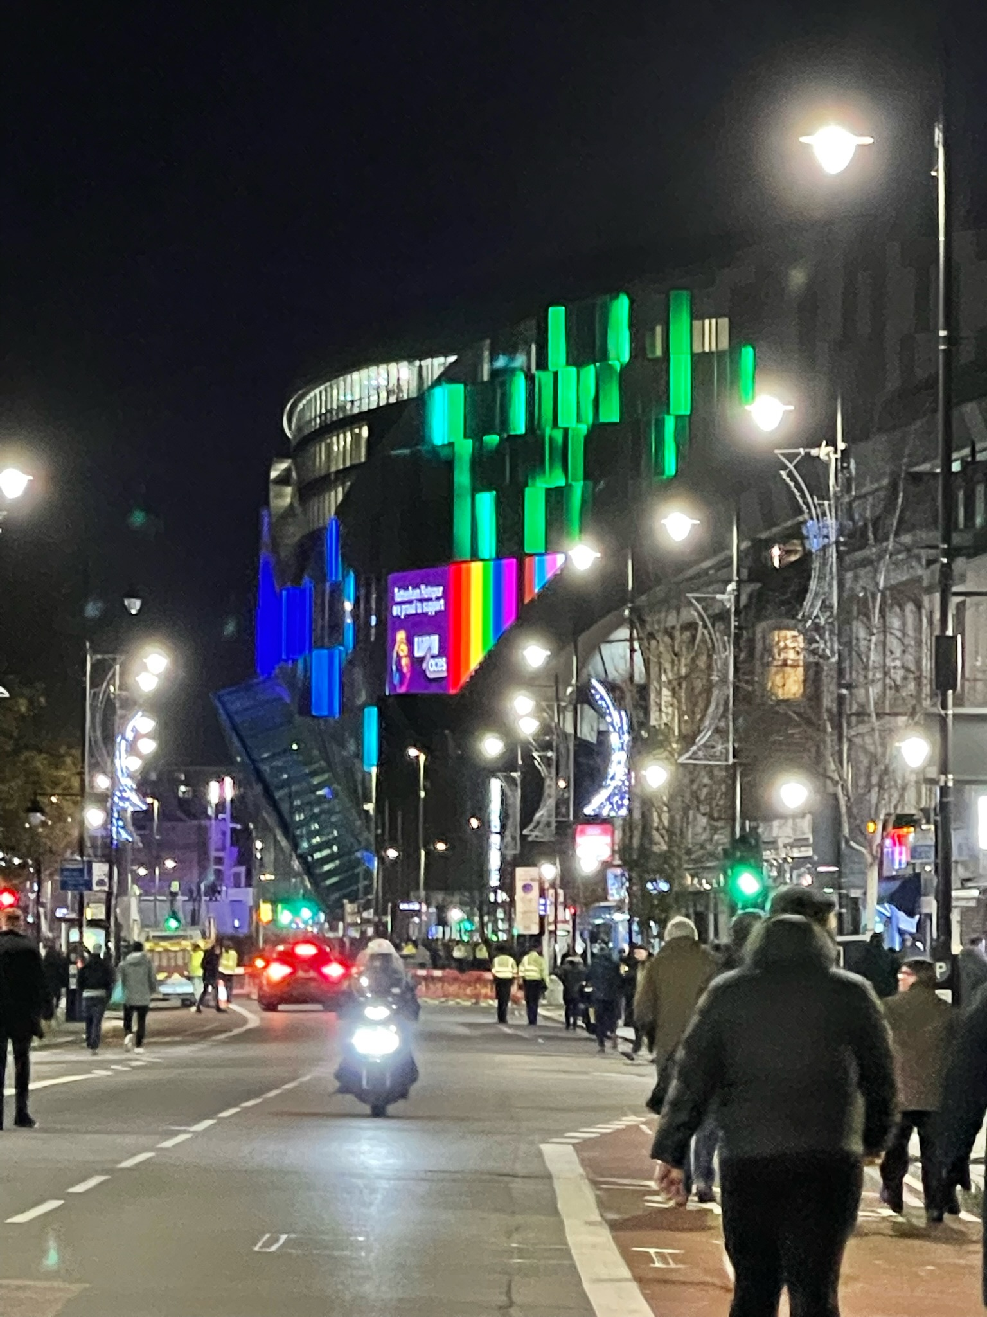
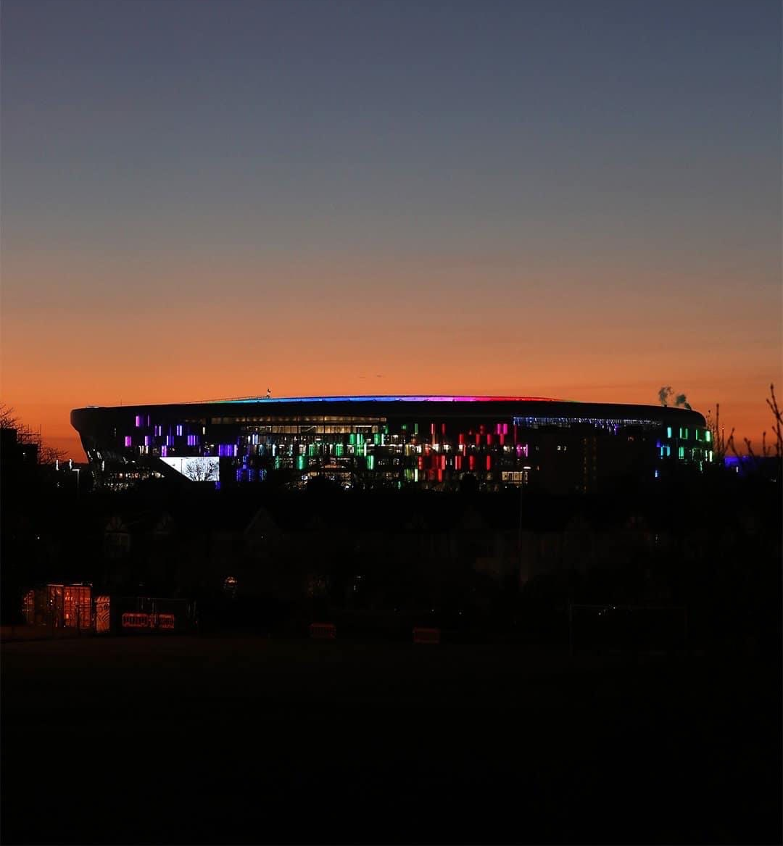
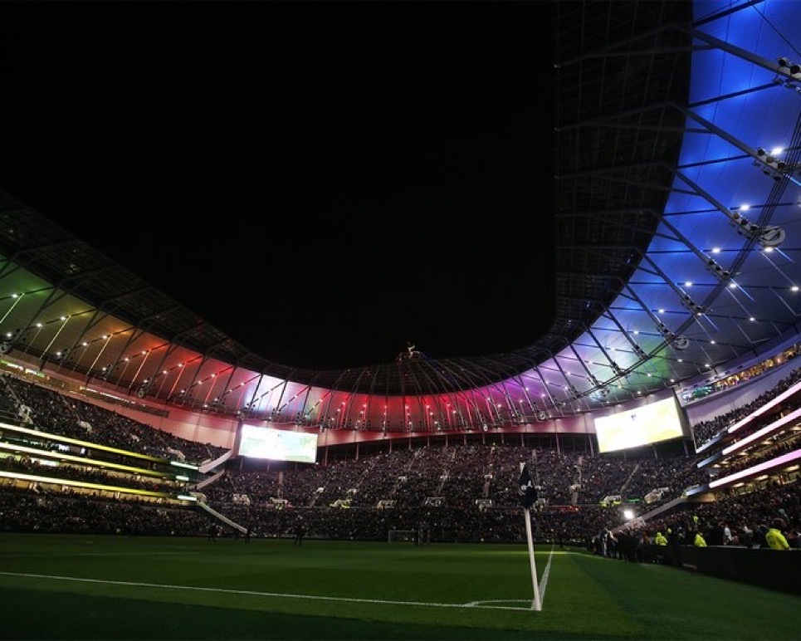
And the club fully embraced this Rainbow Laces campaign by once again illuminating the Tottenham Hostspur Stadium into the now iconic ‘Rainbow Stadium’
Notes:
Look how beautiful this is

Slide 16
Football v Homophobia

Slide 17
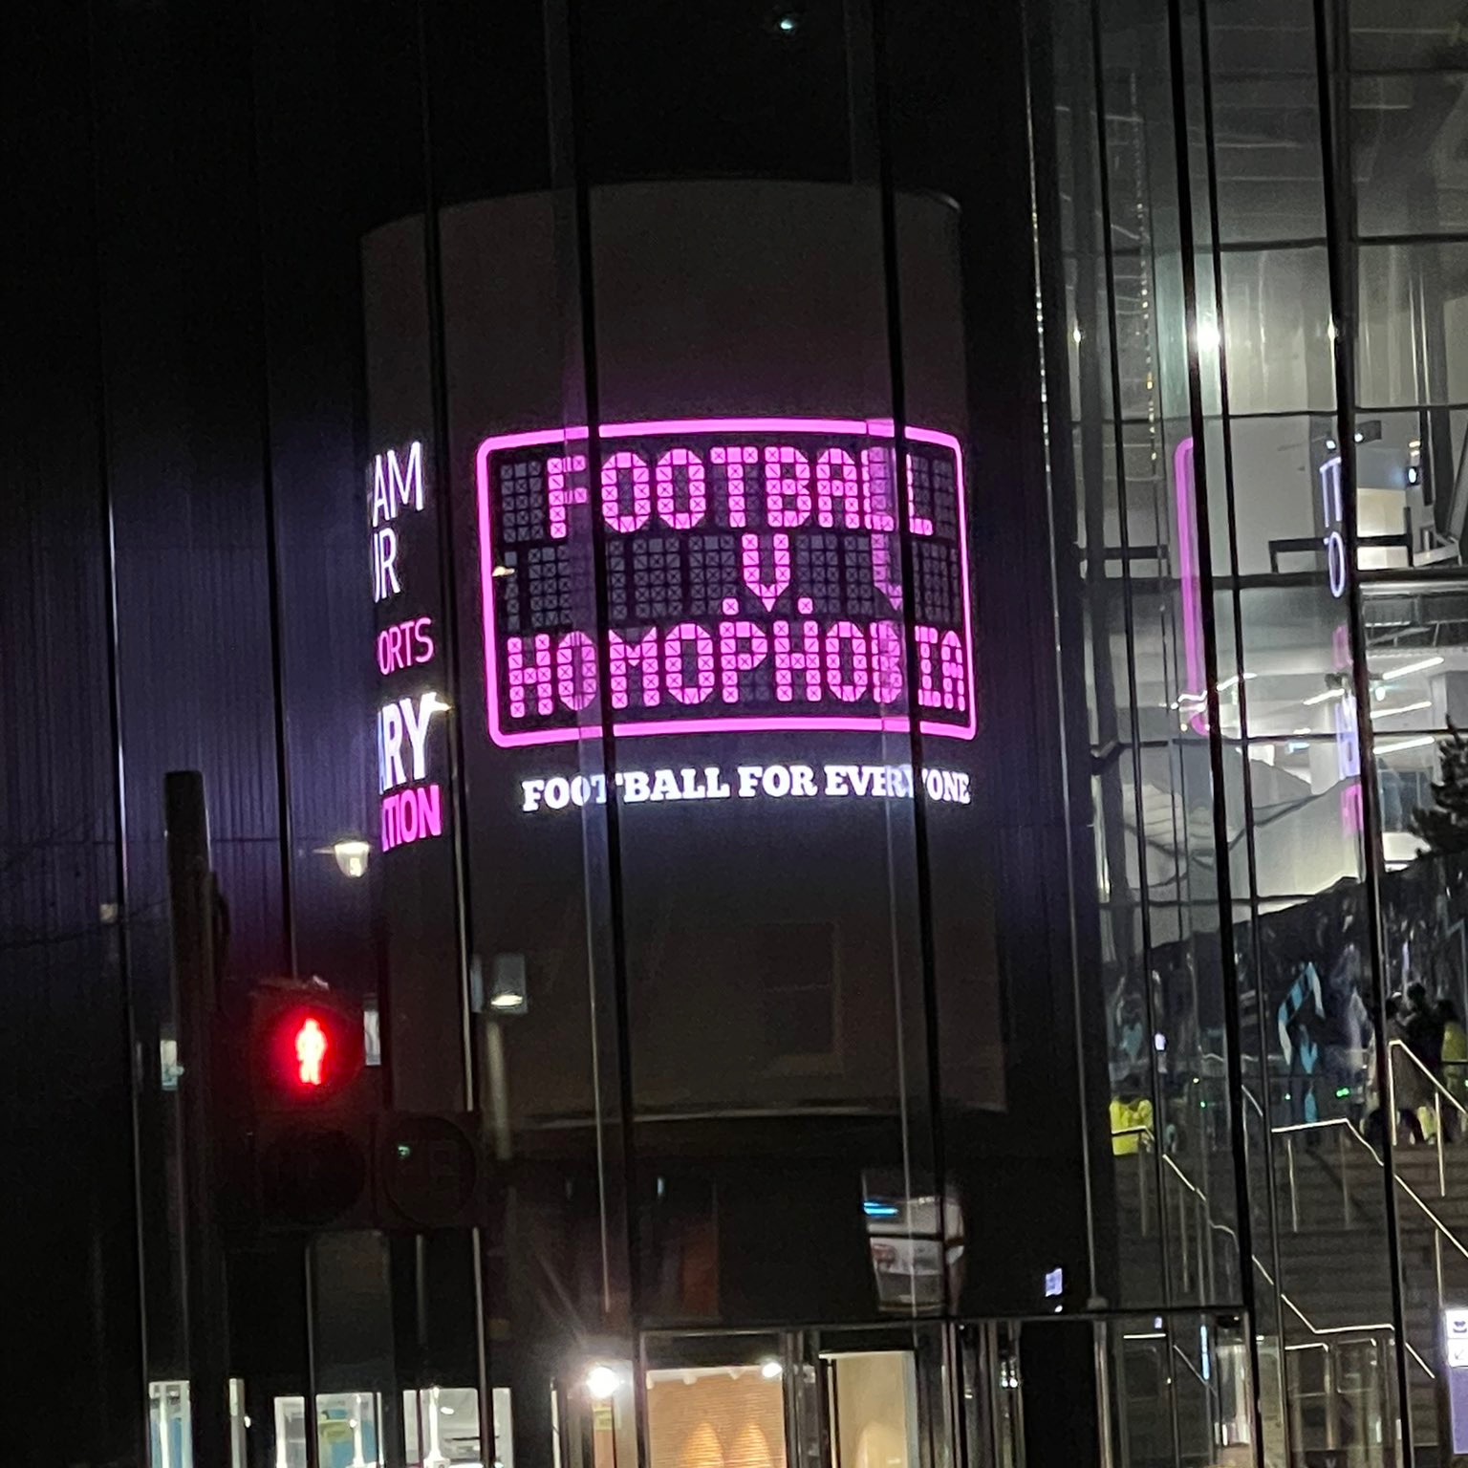
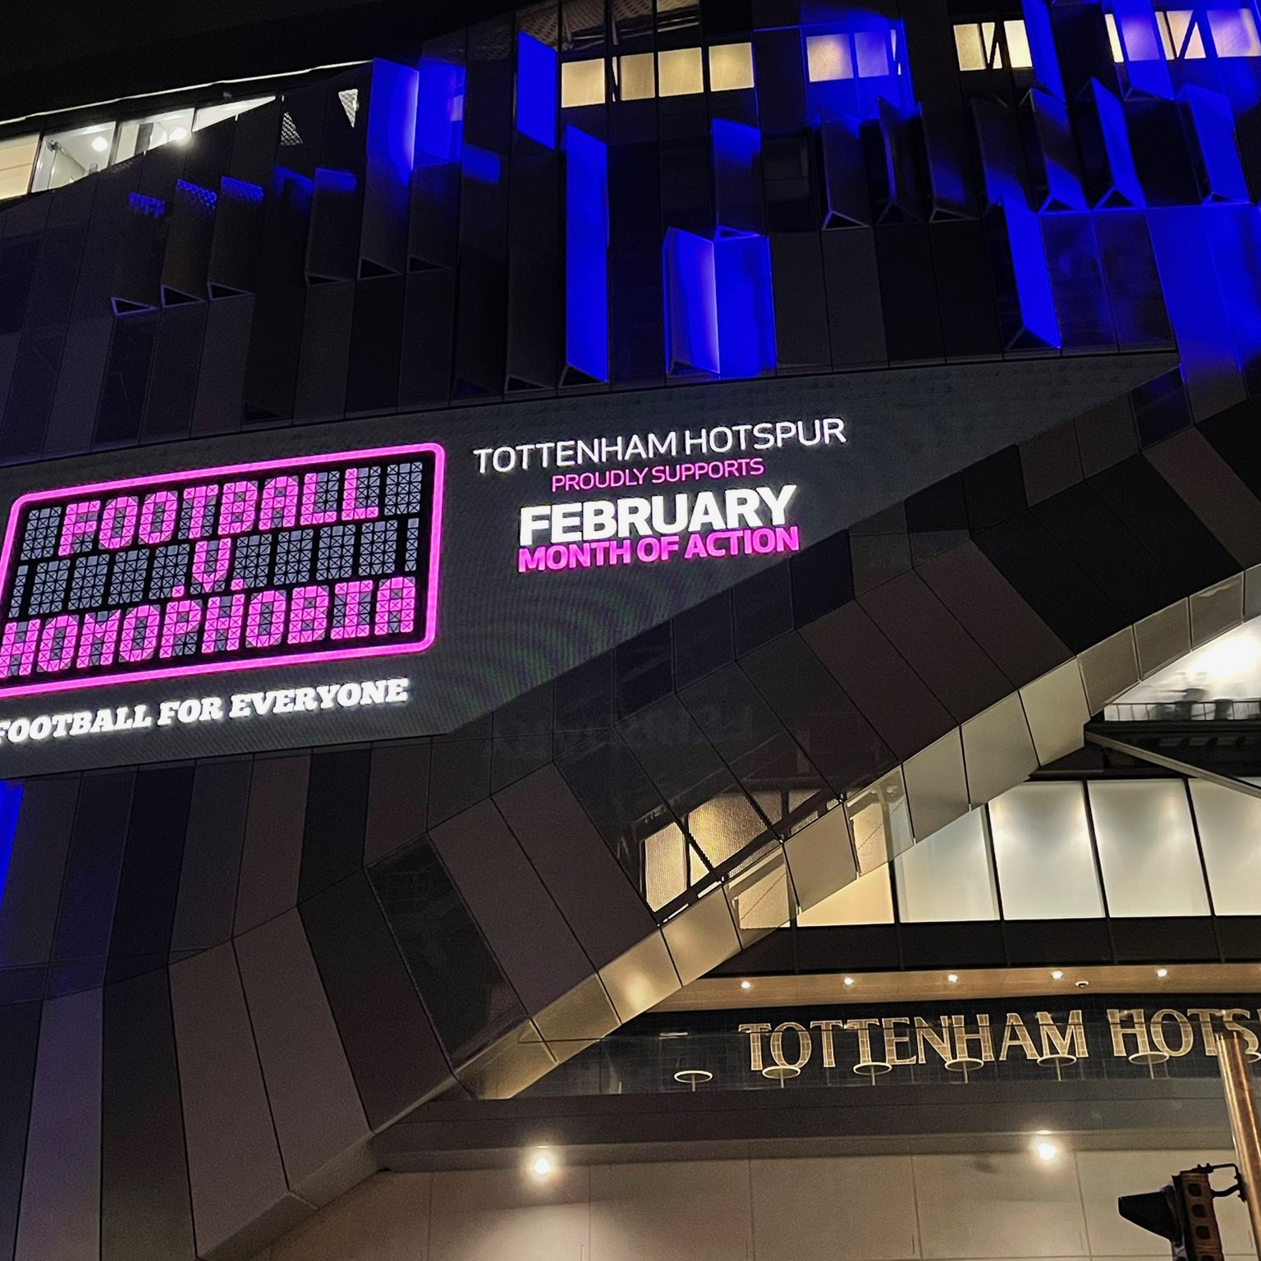
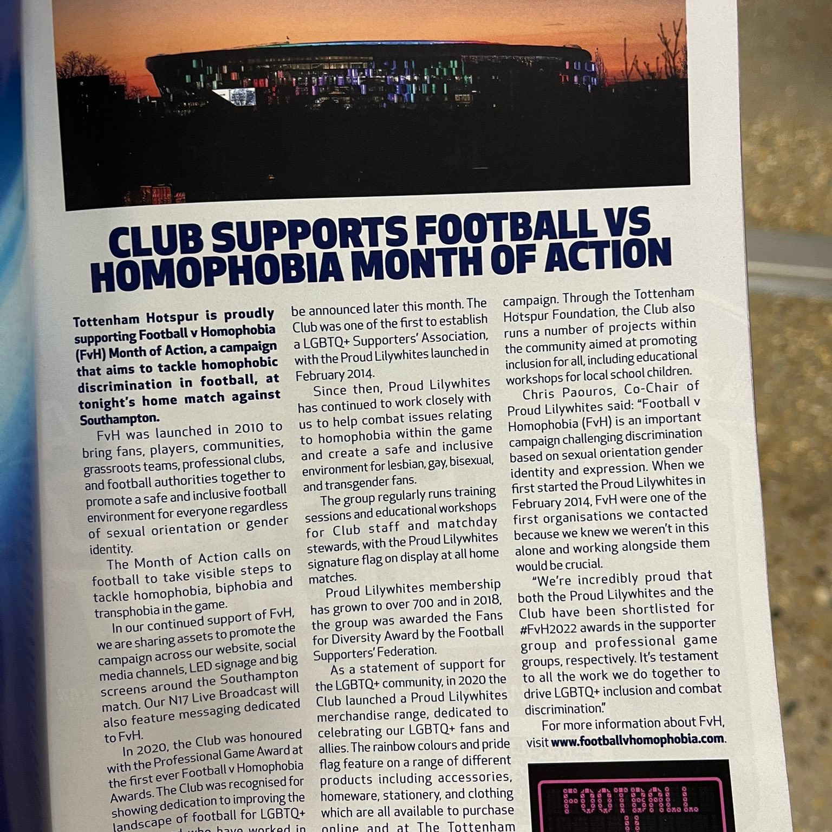
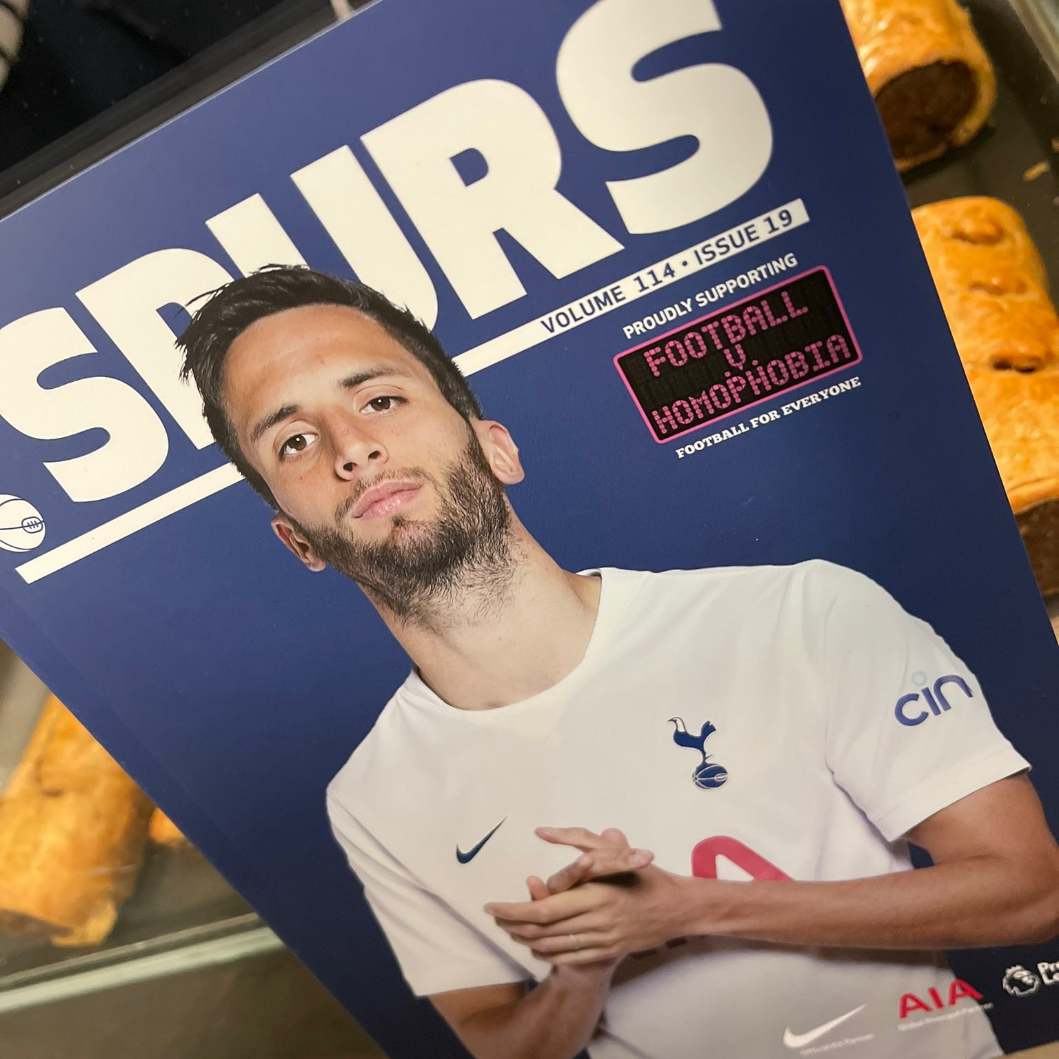
Our club supporting the FvH campaign
The club displayed the FvH logo around the stadium, and partnered with us to create a piece for the match day programme
Notes:
This is a big deal for a top PL Club--it's a grassroots campaign that's not mandated by the Premier League, but because we care about it, they do too

Slide 18
Black History Month 2022

Slide 19
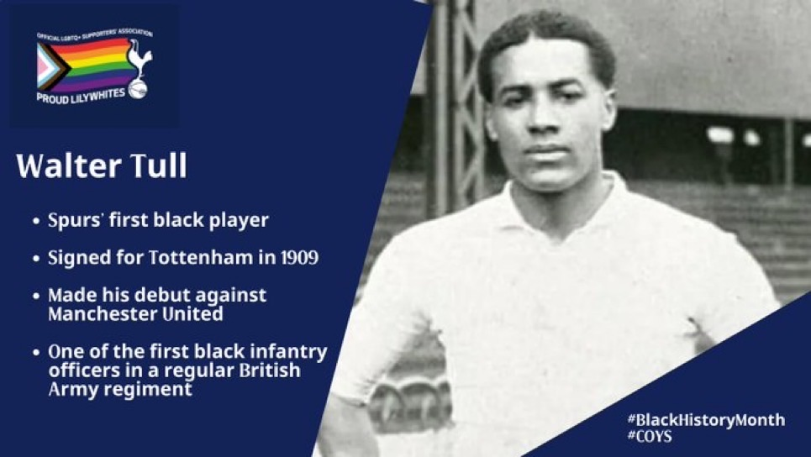
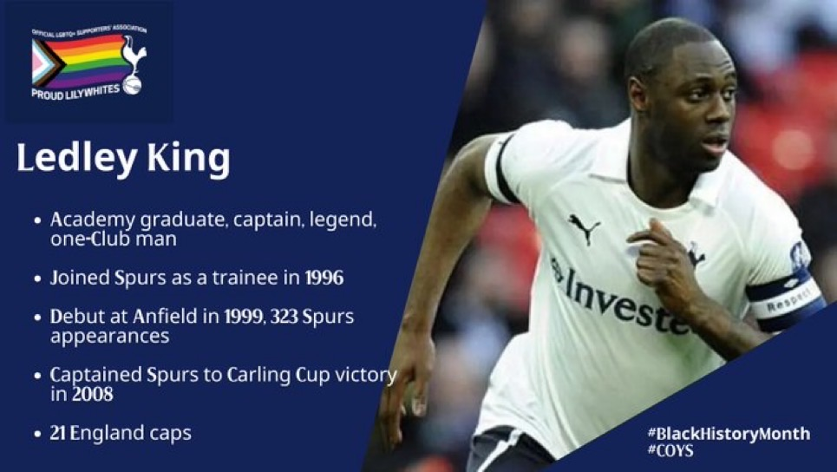
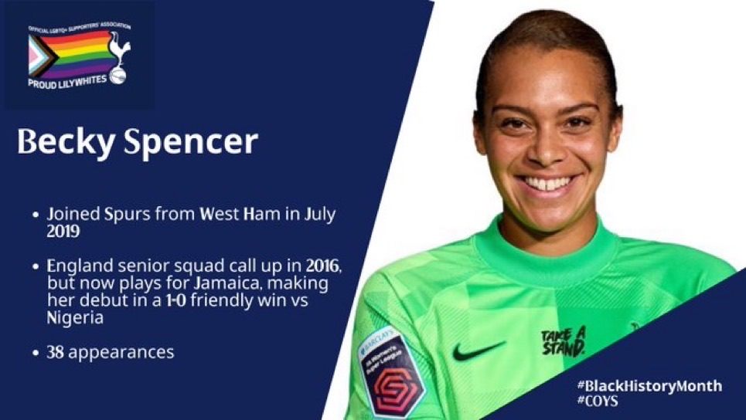
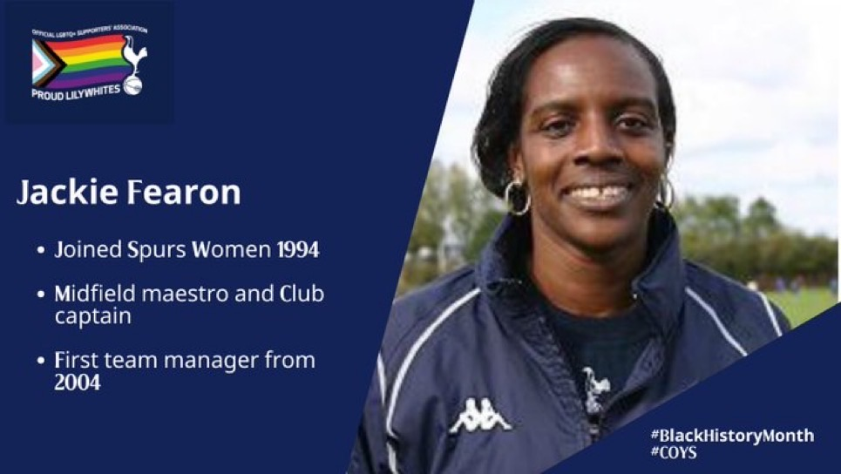
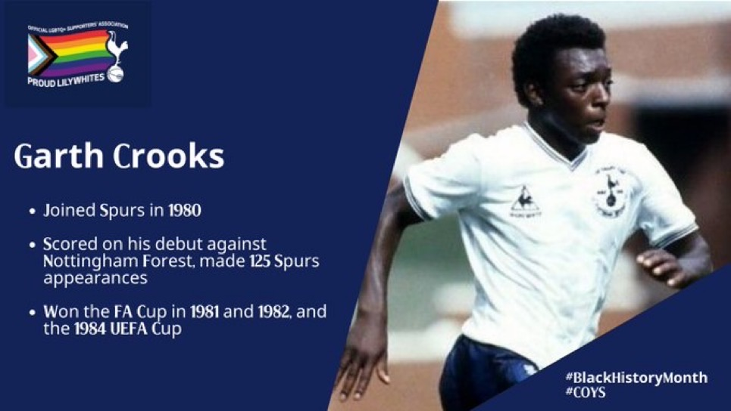
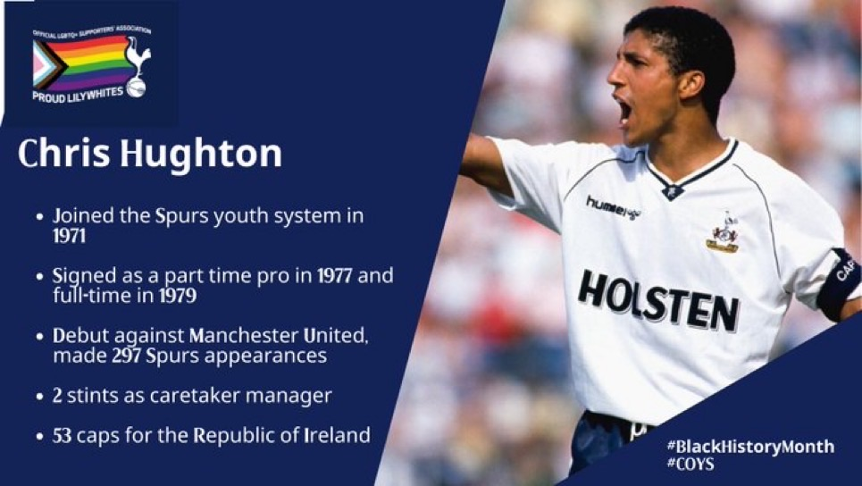
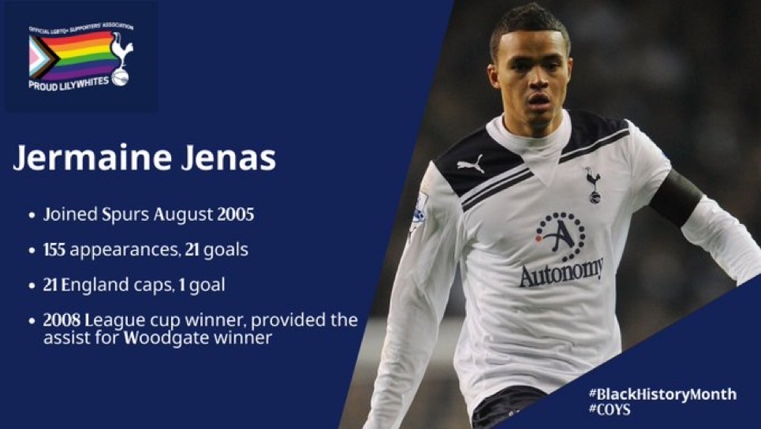
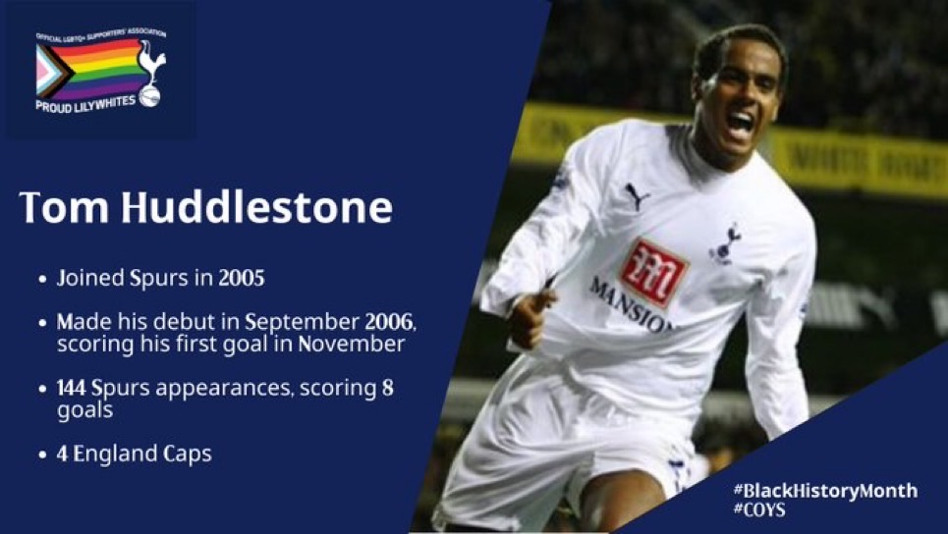
During Black History Month, we celebrated a number of our black players, past and present
Notes:
Past and present and many more than this--Jackie Fearon

Slide 20
The wider community

Slide 21
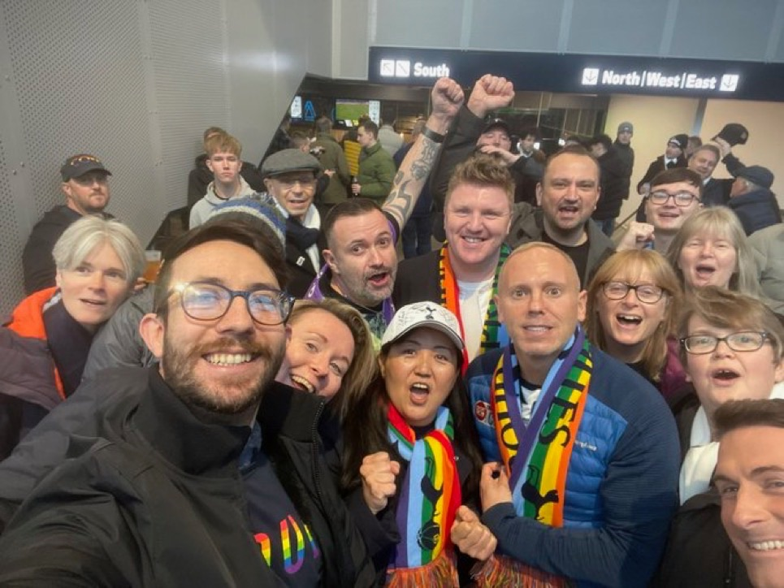
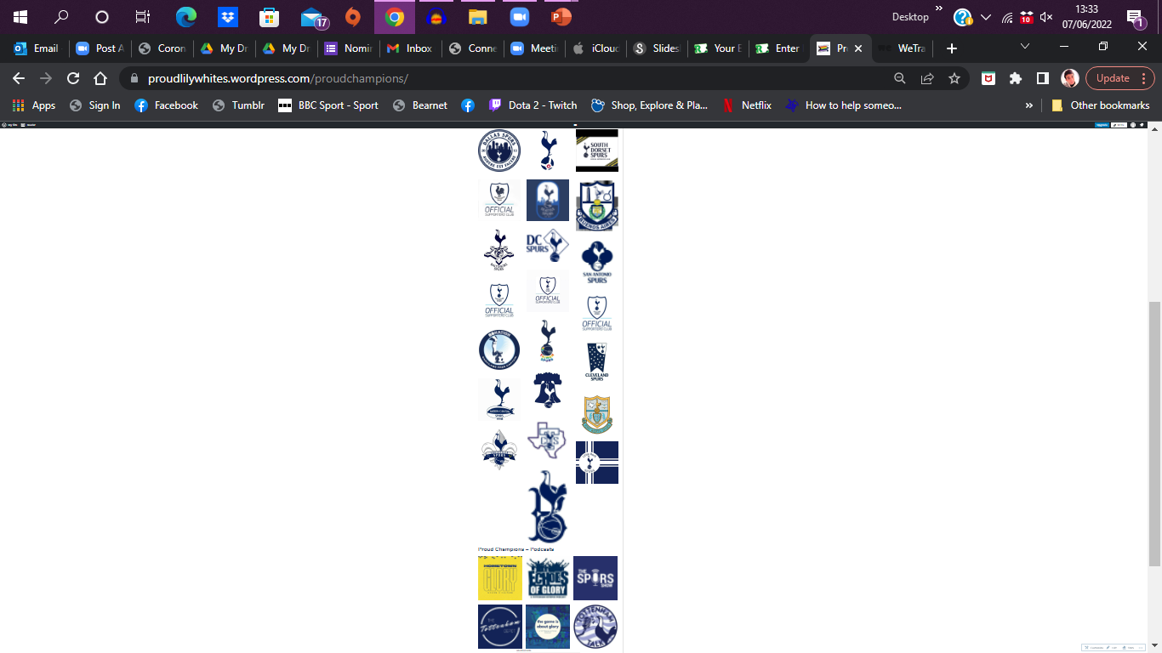
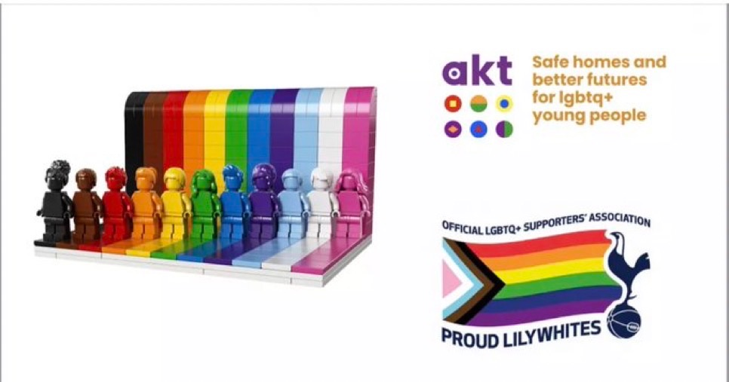
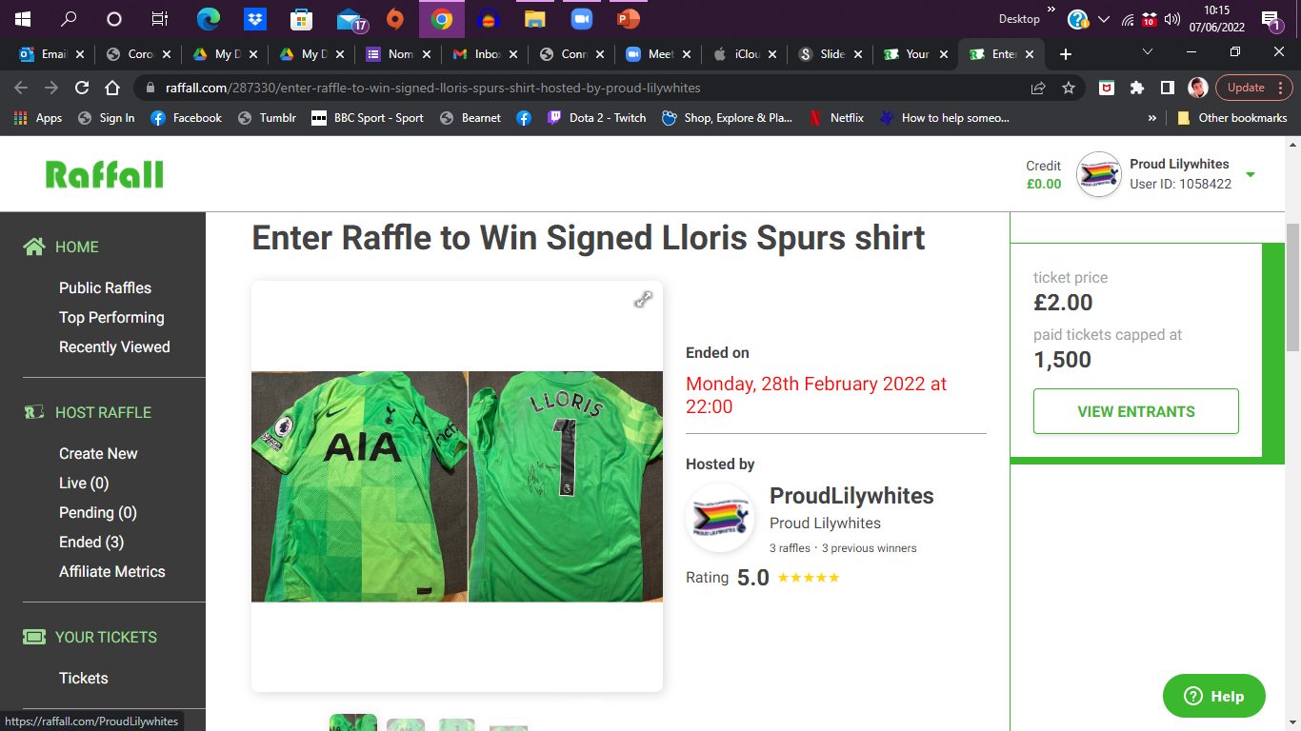


We raised well over £2000 for charity this year through raffling some amazing items!
We also launched our Proud Champions initiative, to partner with Official Supporters Groups to promote inclusivity across the whole Spurs network
And we even met Judge Rinder and welcomed him to the Proud Lilywhites family
(He was really happy to join us, we promise!)
Notes:
Charity stuff crucial -- for AKT, for ourselves, for FvH and Noah's ark
And importantly, the new PLPC--and these aren't even all the logos, we asked and they came knocking:
Other Spurs fan groups and podcasts -- committed to upholding our values and being a positive voice for LGBTQ+ inclusion and diversity more broadly. About their LGBTQ+ fans knowing they are a safe space and other LGBTQ+ Spurs fans from across the world knowing there is safe space for them to watch spurs if they are on holiday etc
even though he looks like he's been taken hostage!

Slide 22
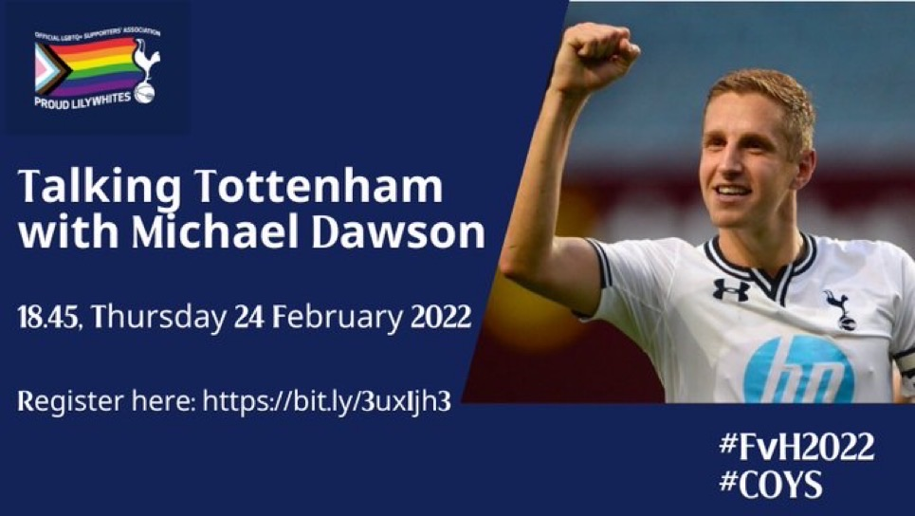

We were joined by a very special guest for our Talking Tottenham series – Spurs legend and ambassador: Michael Dawson
Notes:
One of my favourite nights, what a guy!

Slide 23



In 2022, we were again nominated for the annual FvH awards, alongside the club, for Supporters Group & Professional Club respectively
Notes:
But didn't win--crazy!

Slide 24
Players of the Season

Slide 25


The Men’s winner was Heung-Min Son
We voted on our Players of the Season for both the Men’s and Women’s teams
The Women’s winner was Ash Neville
Notes:
Sonny, sweeping the board as ever
And Ash is one of our own in more ways than one!

Slide 26
Our Patron: Helen Richardson-Walsh

Slide 27

“What another fantastic year for the Proud Lilywhites. The activity levels have been amazing, helping to consistently provide much needed visibility throughout the season, and not just during official campaigns.
It’s been great to see our relationship with the Club go from strength to strength, and with that a broader audience is being engaged all the time. This undoubtedly is helping to increase the understanding of the role we can all play in ending discrimination from our game altogether, the impact of which impact can’t be underestimated.
Well done to the entire team that is making this happen everyday, onwards we go - to dare is to do!

Slide 28









We’d like to thank everyone that helped make our 2021/22 such a successful season…
Stay safe everyone
COYS!

